Slide 1
ADEC Engine Start Information
This document is geared to help diagnose fuel system issues. It assumes that the engine will crank over and is mechanically sound. Good compression, valves adjusted and mechanically timed correctly.
In an effort to troubleshoot an engine, the Diasys data will give you clues, but it may not give a definite answer. When this data is used as a tool for investigation of the engine components, it will point you in the right direction.
The first step is to understand the recent history of the engine.
Why did it stop running? Was it run out of fuel? Did it run before someone welded on the frame? This may give you clues.
The engine needs several things to start and run.
No engine stops active.
Low Pressure fuel to feed the HP pump.
Rail Pressure.
Minimum cranking speed.
Injectors opening.
The specific minimum requirements can be found on a later slide.

Slide 2
ADEC Engine Start Information
The most common issue for no start is the E-Stop or other kill switch is off.
We get calls regularly on NO-Start complaints that are due to one or more engine stop switches turned off on the particular piece of equipment. This should be checked first!
Diasys can confirm this quickly.
Low Pressure Fuel
If the engine has been run out of fuel, the most common reason for a no-start is air trapped in the low pressure fuel (feed side) of the fuel system. This is easily diagnosed by monitoring the low side pressure fuel with Diasys.
If the Low side pressure is near 0 bar while cranking the engine, this needs to be corrected. Normally the fuel filters need to be filled with clean fuel and the manual pump used to help push air out of the system. Sometimes this takes quite a while.
If all the air has been removed from the system and there is still 0 bar of low pressure, the LP pump could be damaged. This is not very common, but possible.
This pump consists of 2 gears and a pressure relief valve. If the pump is turning and has fuel supplied, it should make pressure. Debris can hold the spring loaded pressure relief valve open and the pump cannot make pressure.

Slide 3
ADEC Engine Start Information
High Pressure Fuel
If the low pressure fuel is 1bar or higher while cranking, this should be enough to start the engine. This tells you that HP pump is supplied with enough fuel to run.
If the HP (High Pressure) fuel is above 300 bar during cranking, check the items below.
E-Stops OFF?
Engine Cranking Speed?
If the HP Fuel is below 300 bar during cranking, this requires further investigation.
If the E-Stops are off and Cranking speed is OK, the reason for lack of high pressure fuel must be investigated.
When cranking, the pump is in full pumping capacity mode until the engine starts or rail pressure reaches 600 bar. If the HP pump is receiving enough fuel from the LP pump, it should make over 300 bar while cranking. If the HP pump cannot make this much pressure it could be due to a few reasons.
Possible pump control valve issue.
Possible HP pump internally damaged or failed.
HP fuel pressure relief valve damaged or held open by debris.
**For mechanical diagnostic issues, please consult the appropriate operational or workshop manual.

Slide 4
ADEC Engine start Minimum requirements
For common rail Tier 2 Series 2000 and 4000 engines
The engine controller (ADEC) must see certain conditions before fuel will be injected into the cylinders. This includes, ADEC voltage, Minimum Rail Pressure and Minimum Engine Cranking Speed.
Low Pressure Fuel
Low side fuel pressure should be about .75 bar to start
High Pressure Fuel
Minimum rail pressure is 300 Bar before fuel injector will operate.
Engine Speed
Min Cranking Speed = 90 RPM
ADEC Voltage
ECU Power Supply Voltage Injectors will not function under 16.8V
Engine Stop Commands
OFF
Actual amount of fuel injected
You must look at Main Fuel Mass / Cycle to see if fuel is being injected.

Slide 5
ADEC Engine Start Information
Low Side Pressure Fuel 1.0102.001 P-Fuel
Measured Rail Pressure 1.0104.001 P-HD Common Rail
Rail Pressure Commanded by ADEC 1.1300.103 P-Railfuel Demand
Difference between Commanded
and Measured Rail Pressure 1.1300.104 P-Railfuel Deviation
Actual amount of fuel injected 1.1020.601 Main Fuel Mass / Cycle
Engine Speed 1.2500.044 Engine Speed ECU
ADEC Voltage 2.0140.001 ECU Power Supply Voltage
Engine Stop Commands See Next Slide

Slide 6
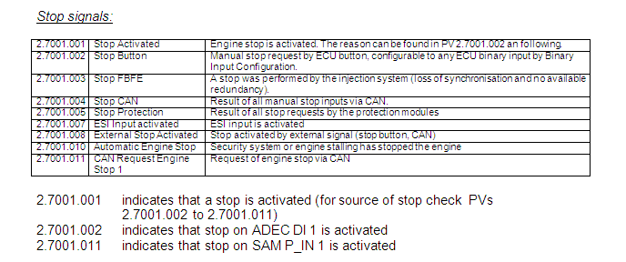
ADEC Engine start Parameter Information
Below are the engine stop signals.
2.7001.001 indicates that some type of stop is active.
The other numbers are the details of which stop mode is active.
If 2.7001.001 is active (=1) then the engine will not inject fuel.

Slide 7
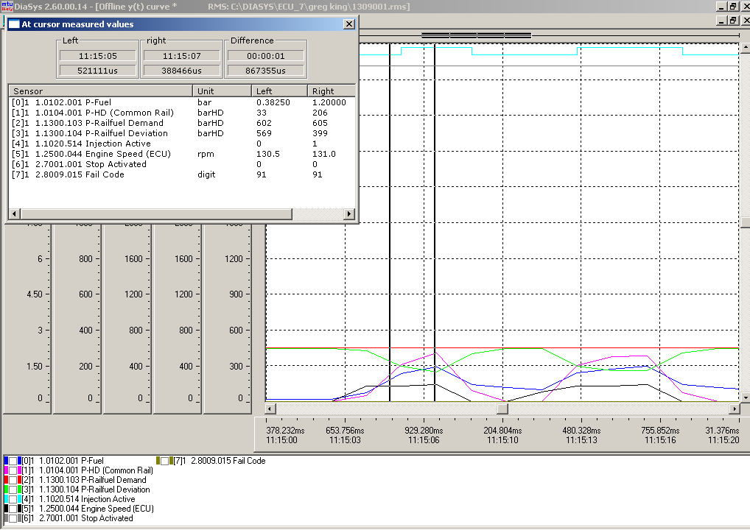
Example #1 No start
P-Fuel 1.2 Bar
P-Railfuel Demand = 605
P-HD (common rail) 206
Engine Speed ECU = 131 RPM
Stop Activated = 0
Root cause: Failed HP Fuel Pump

Slide 8
Example #1 No start
P-Fuel 1.2 Bar (OK for start)
P-Railfuel Demand = 605
P-HD (common rail) 206 (NG, Under 300bar)
Engine Speed ECU = 131 RPM (OK for start)
Stop Activated = 0
Root cause: Failed HP Fuel Pump

Slide 9
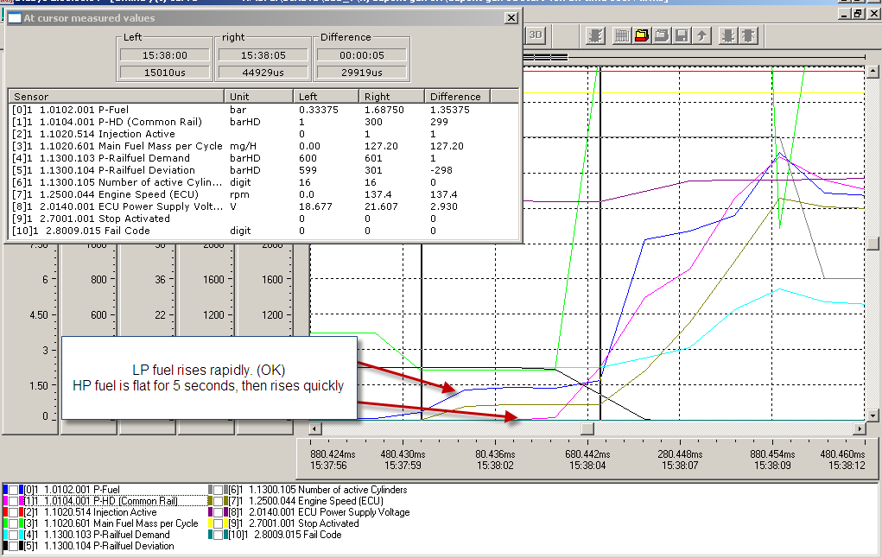
Example #2 Long Crank Time
P-Fuel 1.2 Bar
P-Railfuel Demand = 601
P-HD (common rail) =1 for 5 seconds then jumps to 300.
Engine Speed ECU = 131 RPM
Stop Activated = 0
Voltage is low
Root cause: HP fuel drains after shutdown. Result: long crank time.

Slide 10
Example #2 Long Crank Time
P-Fuel 1.2 Bar (OK for start)
P-Railfuel Demand = 601
P-HD (common rail) =1 for 5 seconds then jumps to 300. (NG, Under 300bar)
Engine Speed ECU = 131 RPM (OK for start)
Stop Activated = 0
Voltage is low, but still OK.
Root cause: HP fuel drains after shutdown. Result: long crank time.

Slide 11
Thank You !

