Slide 1
Export Software / Cal File In Diasys
If you need to share a calibration file, it can be exported through Diasys.
You must have a copy of the cal file on your PC.
This can be done in two different ways.
Either download a copy from the mainframe or if you have plugged into a controller, it will have saved a copy of the cal on your PC.
July , 2012
1

Slide 2
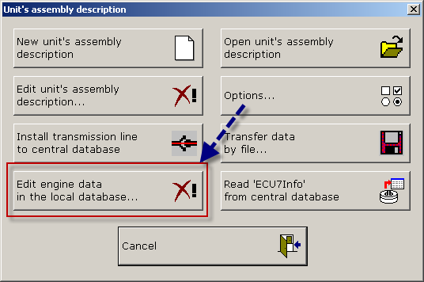
You can check calibrations available for export by opening “edit engines in local database””.
July , 2012
2

Slide 3
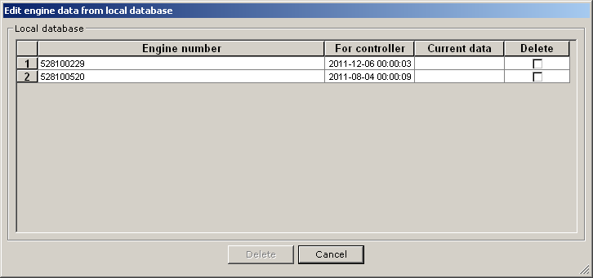
This will list any calibration files available for export on your PC
July , 2012
3

Slide 4
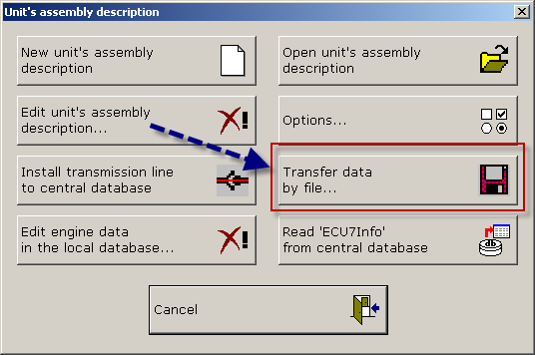
This is the export / import button
July , 2012
4

Slide 5
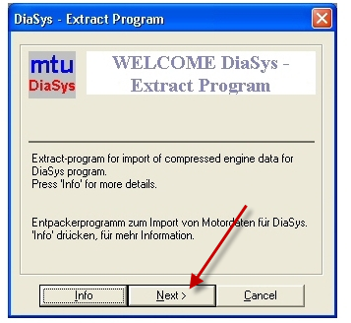
Import cal with Diasys
If cal was renamed with .TXT or other extension for emailing purposes, rename cal file to .EXE extension.
Double click on renamed cal file ******.EXE
You will see this message:
July , 2012
5

Slide 6
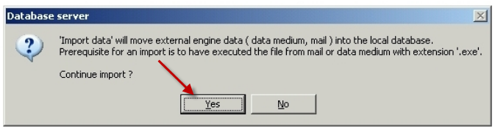
Select YES
July , 2012
6

Slide 7
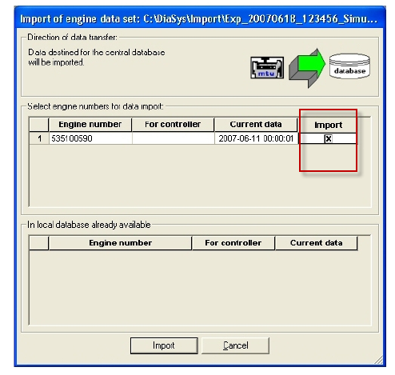
Select the serial number of the file you want to import.
You can import more than one at a time.
Cal file will be placed in the Diasys folder with the correct serial number.
Open Units Description and program like usual.
July , 2012
7

Slide 8
Cal file export
After you have connected to an engine, you can save the data file as back up. Or download a cal file and send to a colleague.

Slide 9
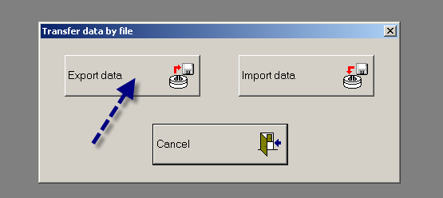
Cal file export
NOTE!!!!!!!!!!!
Only one file at a time can be saved in Export folder.
Each new cal exported will force the deletion of anything in this folder.
The folder is located in C:/Diasys/Export

Slide 10
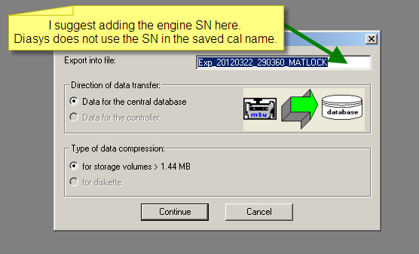
Cal file export
NOTE!!!!!!!!!!!
Only one file at a time can be saved in Export folder.
Each new cal exported will force the deletion of anything in this folder.

Slide 11
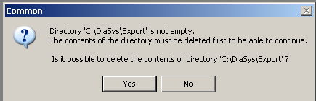
Cal file export
NOTE!!!!!!!!!!!
Only one file at a time can be saved in Export folder.
Each new cal exported will force the deletion of anything in this folder.

Slide 12
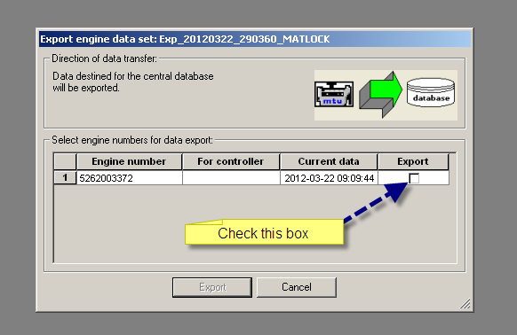
Cal file export
NOTE!!!!!!!!!!!
Only one file at a time can be saved in Export folder.
Each new cal exported will force the deletion of anything in this folder.

Slide 13
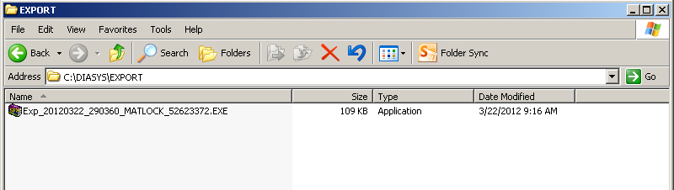
Cal file export
Move the file from here !!!!!
This will be erased when exporting the next file !!!

Slide 14
Cal file export
The exported file is in a .EXE format.
Find the file on your computer somewhere and double click or “run” the file.

Slide 15
Cal file import

Slide 16
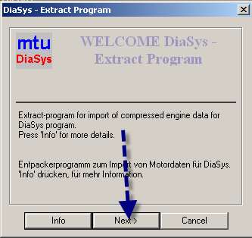
Cal file import
This window should open automatically.
Diasys will unzip the file and place it in the C:\Diasys\Import folder

Slide 17
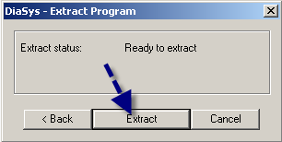
Cal file import
This window should open automatically.

Slide 18
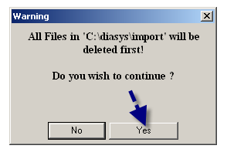
Cal file import
This window should open automatically.
Remember only one cal file can exist in C:\Diasys\Import
If there is something in this folder it will be erased.

Slide 19
Cal file import
After Import was completed, you must open Diasys to continue.

Slide 20
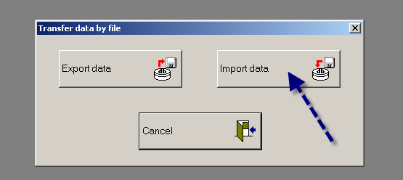
Cal file import
After Import was completed, you must open Diasys to continue.

Slide 21
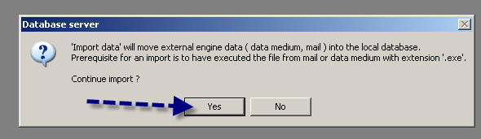
Cal file import
This file will automatically be placed in the folder with the same engine Serial Number.
It will overwrite the existing cal in this folder.
Done!

