Slide 1
This presentation will cover:
Diasys File storage and ADEC reprogramming
Calibration Exporting and Importing

Slide 2
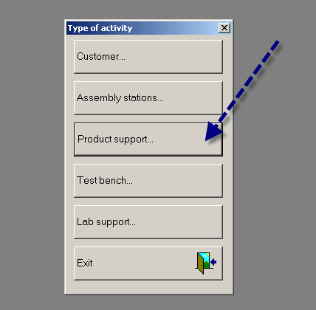
Diasys File storage and ADEC reprogramming
Select Product Support

Slide 3
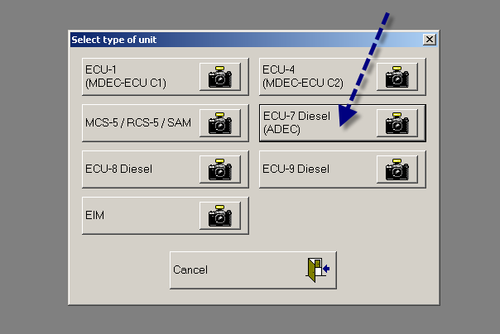
Diasys File storage and ADEC reprogramming
Select Controller

Slide 4
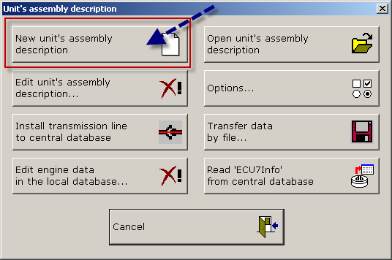
Diasys File storage and ADEC reprogramming
You have to create an assembly description the first time you plug into an engine. It should be called Engine Description.
This creates a file for this engine serial number.

Slide 5
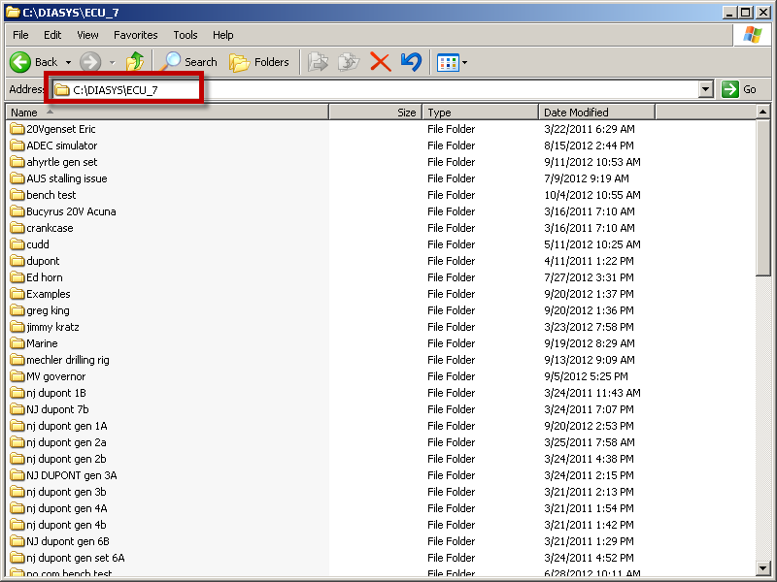
Diasys File storage and ADEC reprogramming
The assembly description is created by Diasys in the C:/Diasys/ECU_7 folder for ADEC ECU_7 units.

Slide 6
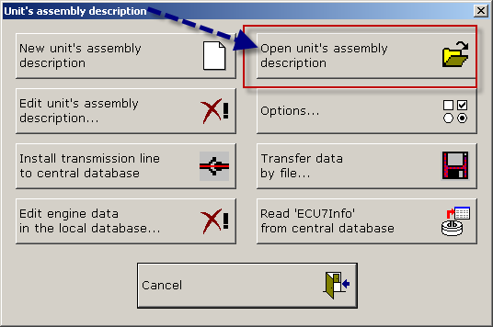
Diasys File storage and ADEC reprogramming
After you have made the file for this engine, open the units assembly description folder.
Diasys will place the downloaded cals in the correct folder based on the Serial Number you entered when making the description.

Slide 7
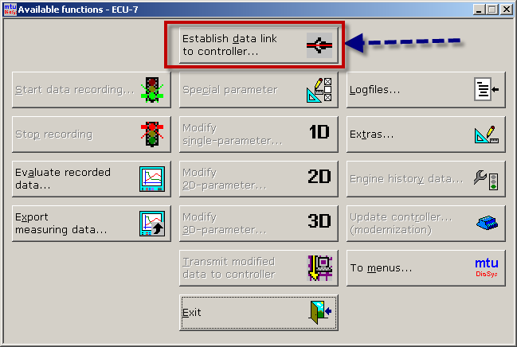
Diasys File storage and ADEC reprogramming
This button connects Diasys to the ADEC

Slide 8
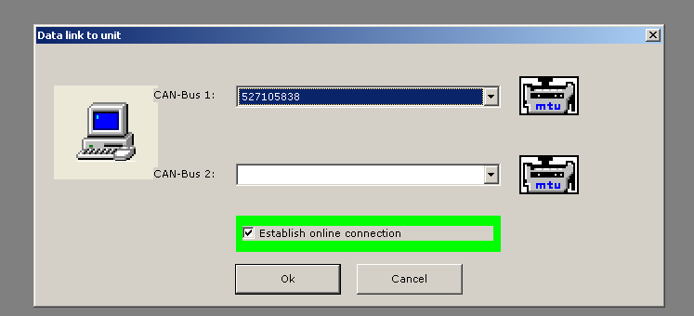
Diasys File storage and ADEC reprogramming
Select the Serial Number using the drop down.
Unless you have a multi engine application like a boat, there will only be one Serial Number.

Slide 9
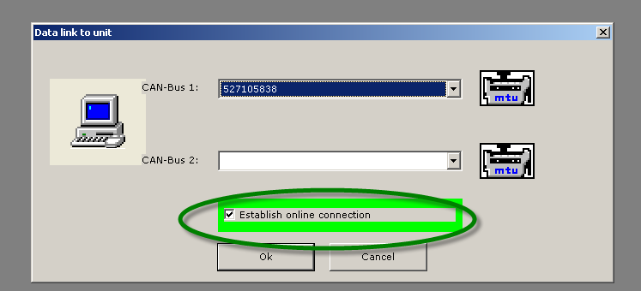
Diasys File storage and ADEC reprogramming
The box with the green outline is critical to the type of programming to be done.
Online connection = Connect and communicate with ADEC. Also update ADEC calibration and or software.
Uncheck if this is ADEC will be deleted and reprogrammed with different serial number.

Slide 10
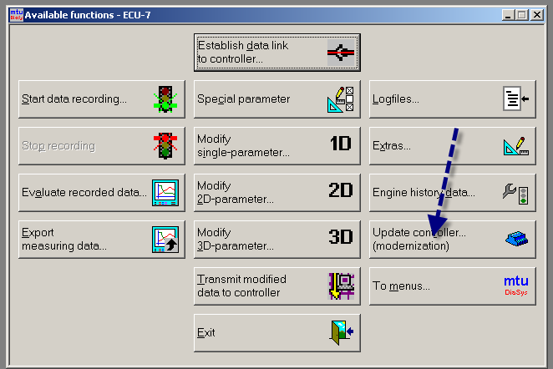
Diasys File storage and ADEC reprogramming
To update an engine calibration, select Update Controller.
All existing data like run time will be saved.

Slide 11
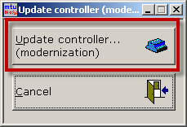
Diasys File storage and ADEC reprogramming
To update an engine calibration, select Update Controller.
All existing data like run time will be saved.
Next Step

Slide 12
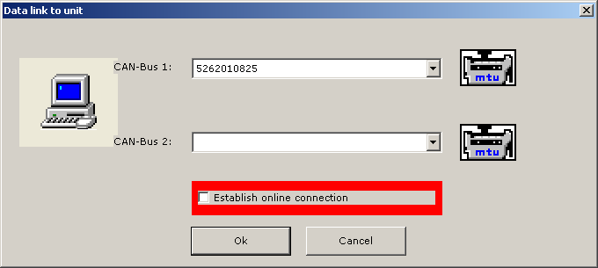
Diasys File storage and ADEC reprogramming
The box with the green outline is critical to the type of programming to be done.
Online connection = Connect and communicate with ADEC. Also update ADEC calibration and or software.
Uncheck if this is ADEC will be deleted and reprogrammed with different serial number or installing a new controller.

Slide 13
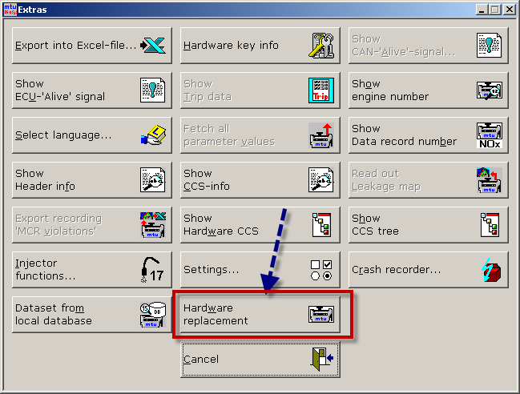
Diasys File storage and ADEC reprogramming
To replace an engine calibration, select Hardware Replacement.
All existing data like run time and serial number will be deleted.

Slide 14
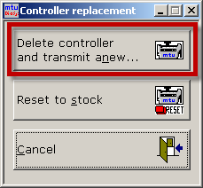
Diasys File storage and ADEC reprogramming
To replace an engine calibration, select Hardware Replacement.
All existing data like run time and serial number will be deleted.
Next Step

Slide 15
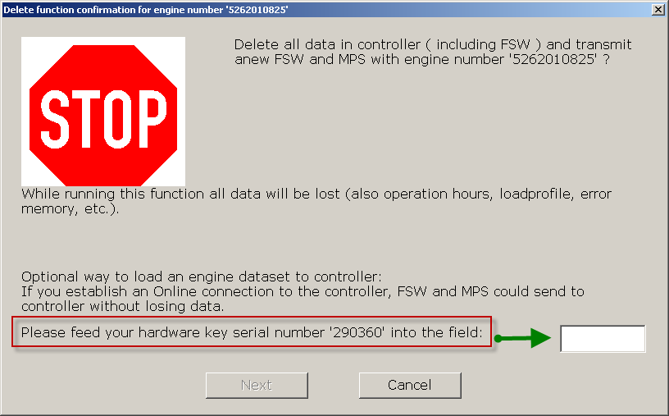
Diasys File storage and ADEC reprogramming

Slide 16
Log file download

Slide 17
Log file download
There are two ways to download log files.
You can select Logfiles or Extra’s.
Log file button will allow you to download:
Error Logs
Modification Logfile
If you go through extra’s, this will allow you to download:
Error Logs
Modification Logfile
Engine History Data (Load Profile)
Parameter Values

Slide 18
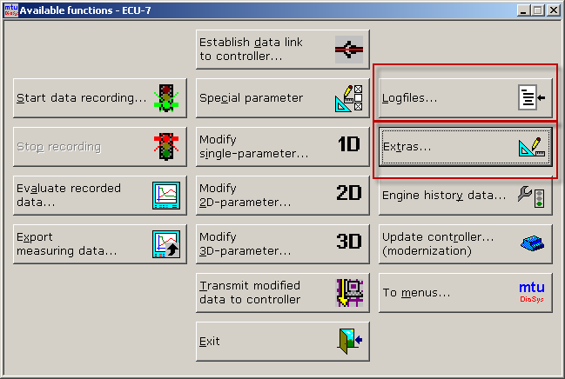
Log file download
There are two ways to download log files.
You can select Logfiles or Extra’s.

Slide 19
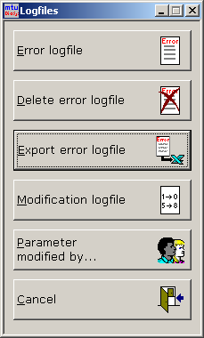
Log file download
If you select Logfiles, you will see the options below..

Slide 20
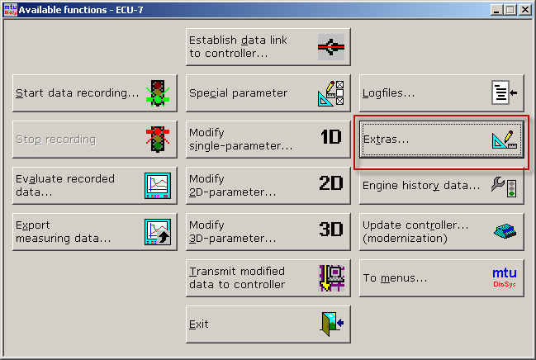
Log file download
To download multiple files, push Extra’s button.

Slide 21
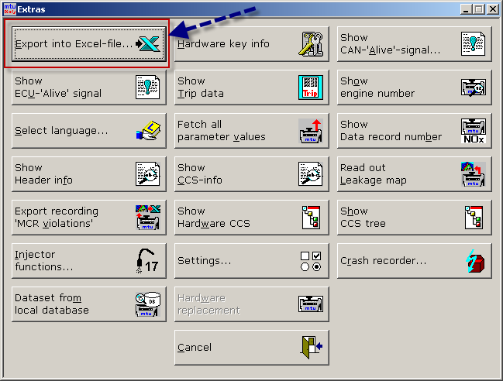
Log file download
Select Export in Excel..

Slide 22
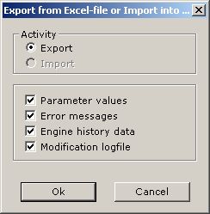
Log file download
Select which files you want to export to Excel..

Slide 23
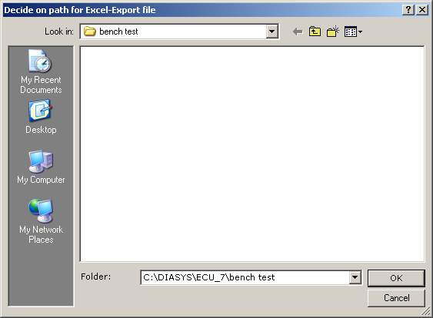
Log file download
Select the folder for the Excel files..

Slide 24
Thank You

