Slide 1
MTU Electronics
Welcome to MTU electronics informational meeting.
We will cover:
Explanation of calibrations and software.
How calibrations are made.
Connecting to the ECU
ECU input and outputs
Fault Logs
Recording Data
Upload and download from the server
SAM CF cards
CF card programming

Slide 2
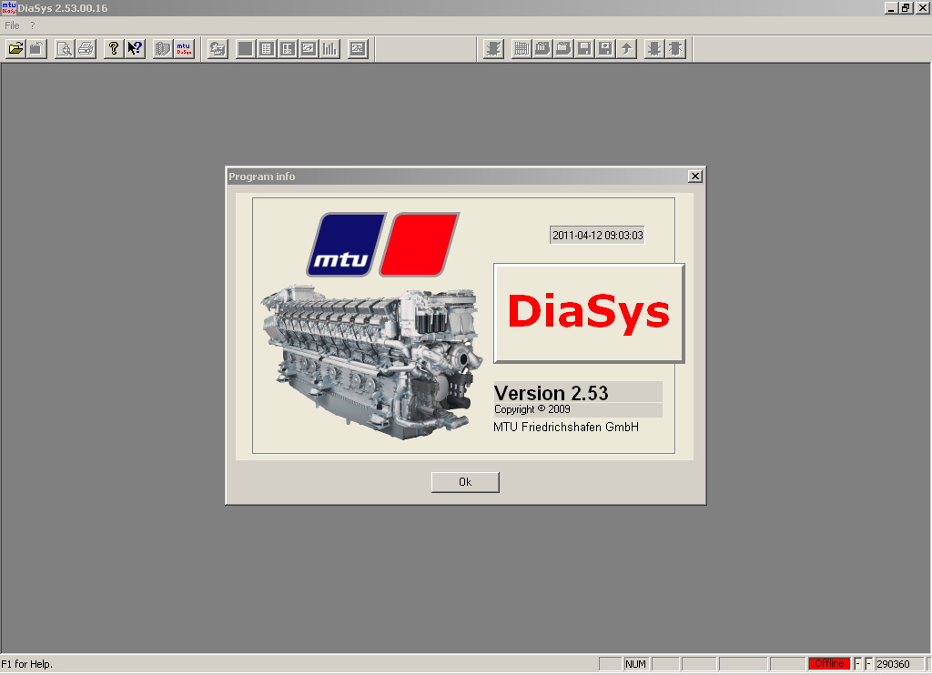
MTU Electronics

Slide 3
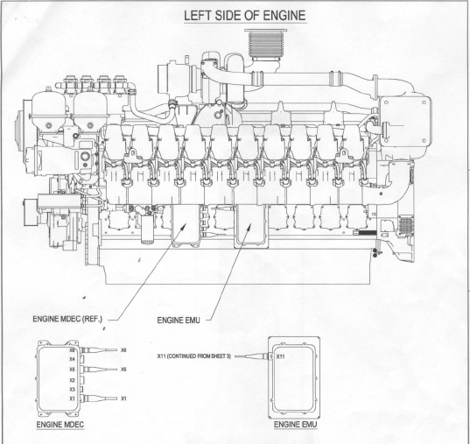
MTU Electronics
The engine controller on an MTU series 2000 or 4000 could be:
MDEC
ADEC
DDEC
Diasys is a laptop based electronic tool that supports MDEC and ADEC controllers.

Slide 4
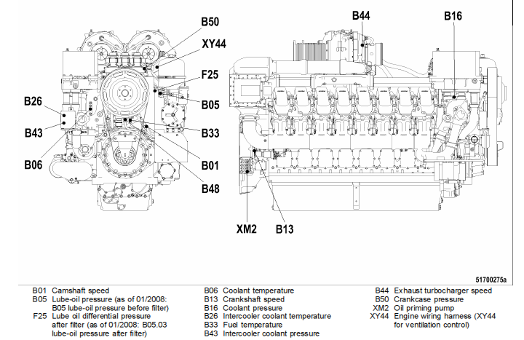
MTU Electronics
The engine controller is required for operating the engine.
By using various sensors and other electronic components, it controls fuel delivery and timing.
This means that all speed and load conditions are run by the engine controller.
At the same time, the condition of all sensor wiring and components are monitored by the controller for correct function.

Slide 5
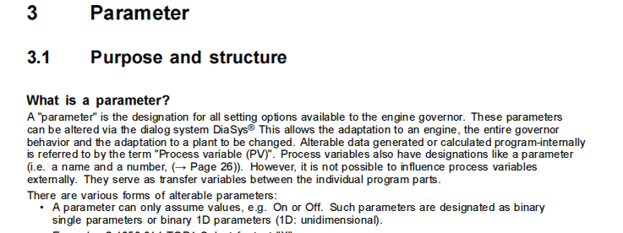
What is a calibration?

Slide 6
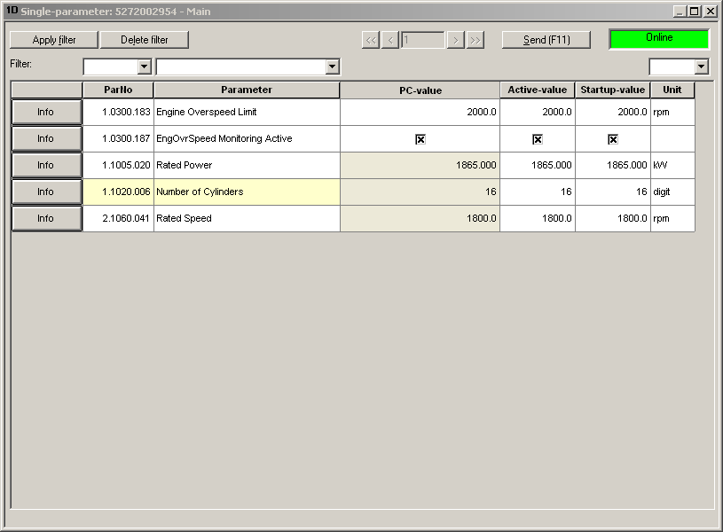
What is a calibration?
This is a 1D parameter.
These are a single value or simply an On / Off switch.

Slide 7
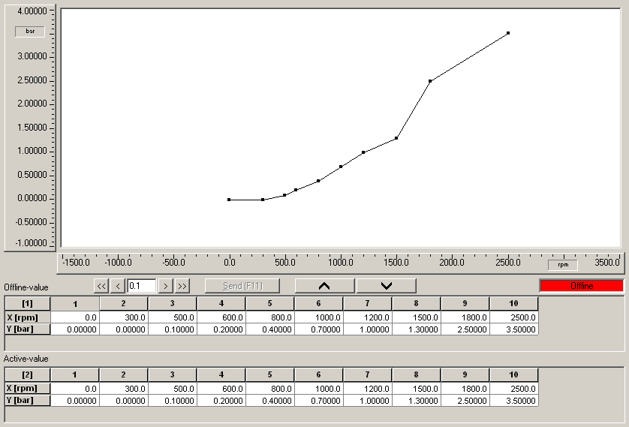
What is a calibration?
This is a 2D parameter.
It is a simple table with 1 axis and one line of data.
This one is for coolant pressure alarm limit 1.
Limit 1 = Yellow Alarm
If the coolant pressure is below this limit, the Yellow alarm will activate.

Slide 8
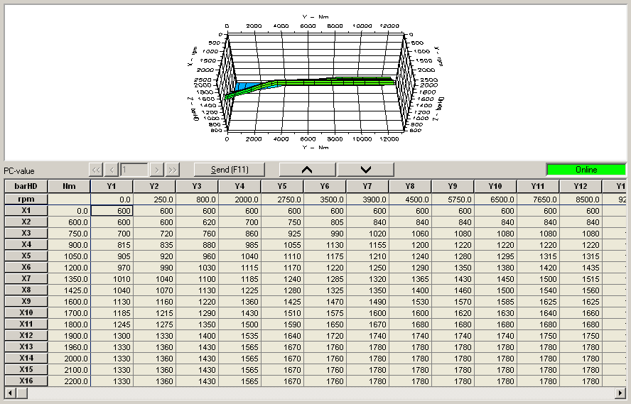
What is a calibration?
This is a 3D parameter.
It has 2 axis and table of data.
This is for Rail Pressure
Based on engine RPM and Engine Torque, this table tells the controller where to set the rail pressure.

Slide 9
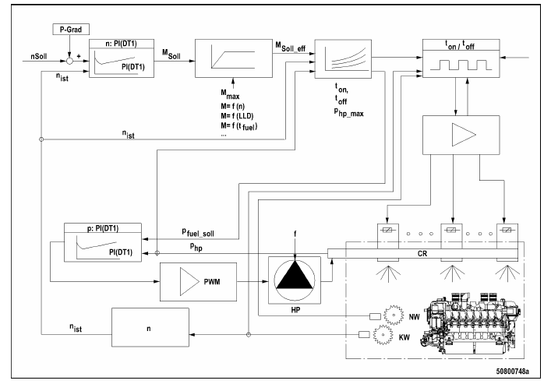
What is software?
This is an example of software logic.
Software is written in code. It can only be accessed by a small group of people.
It is updated frequently for many reasons. New emissions requirements, change in some function, etc.
Logic tables like this instruct the computer how to use the calibration values.
Software documents can be several thousand pages long.

Slide 10
How is a calibration made?
All engines are first calibrated to run well at the emissions testing conditions. This work is done on an engine dyno.
25C Air temp
Sea level
Warm Coolant
After the engine runs well under these conditions, the compensation calibrations are developed.

Slide 11
How is a calibration made?
What is a compensation calibration?
This is an additional calibration used to allow the engine to run well at all environmental conditions outside the emissions test area. Some of these calibrations have to be developed on-site.
High Altitude
Cold or Hot coolant conditions.

Slide 12
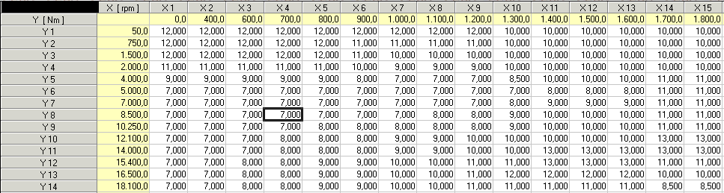
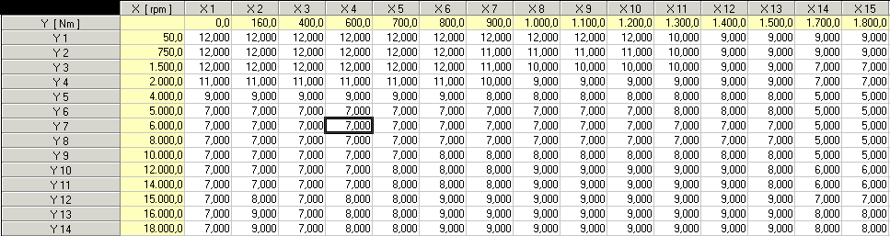
How is a calibration made?
Example of injection timing table for Cold Engine
Example of injection timing table for Normal operating temp engine

Slide 13
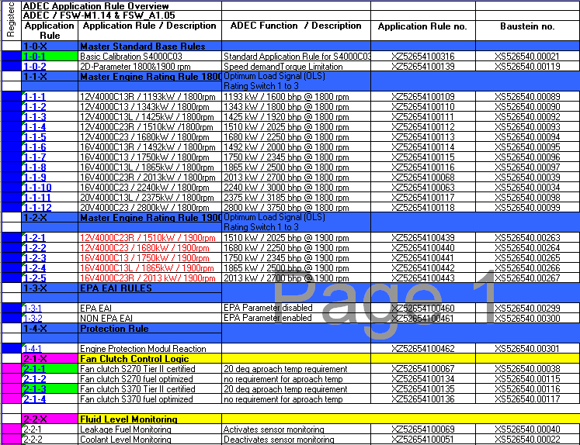
How is a calibration made?
This is a list of calibration rules.
A rule is simply a combination of 1D, 2D and 3D parameters required to enable a certain engine option to operate.
You could call it a calibration package.
Examples would be HP rating,
Throttle control type
Pre-lube available

Slide 14
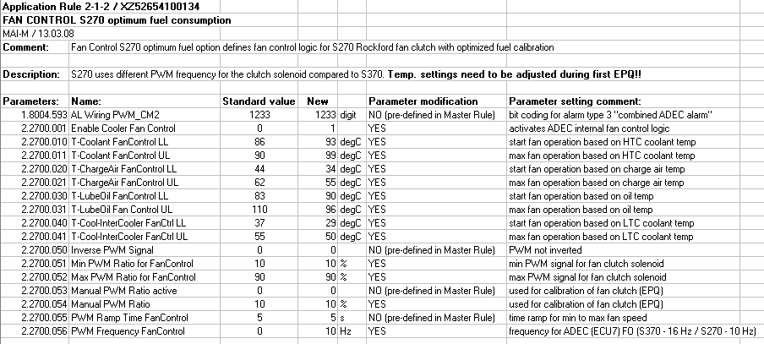
How is a calibration made?
This is the rule for 270 fan clutch.
It lists the correct setting for every calibration required for the 270 fan clutch NON Emissions cal.

Slide 15
Basic information about Diasys
Diasys is the tool required to connect to MTU engine governors
You can use Diasys to:
Check for diagnostic codes
Read current speed and load conditions
Read fueling rate
Check engine history for previous diagnostic codes
Run diagnostic tests on the engine
Make necessary calibration changes

Slide 16
Diasys Operation and Functions
Getting Started

Slide 17
Getting Started

Slide 18
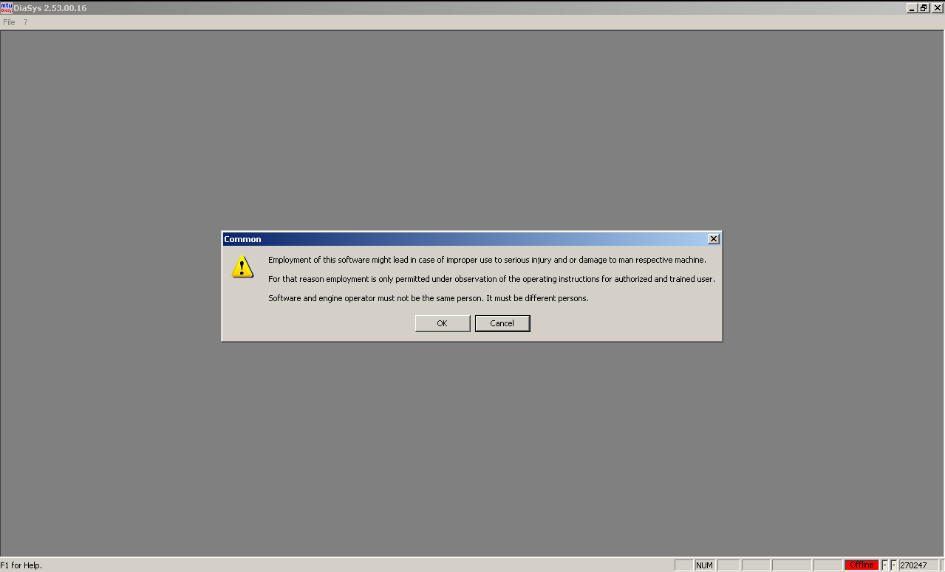
Getting Started
Standard warning appears when starting the software.
Dangers of making unauthorized changes
Protect your personal Diasys key (dongle).
Engine Operation Warning

Slide 19
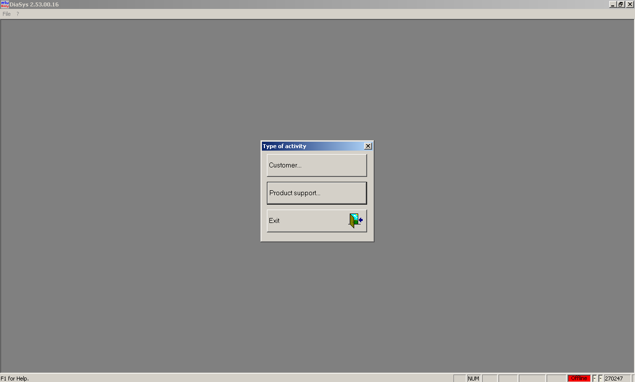
Getting Started
Two Options Available to Trained Field Personnel:
Customer
Few Options or Functionality
Product Support
Most options and Functionality available to Field Personnel
Most common selection for field diagnostics and adjustments

Slide 20
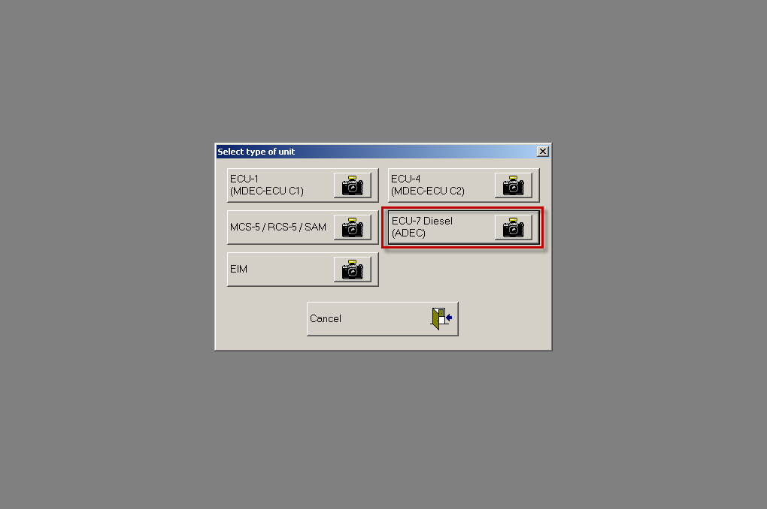
Select the controller you want to connect with.
Options in this screen will vary depending on the users training level. More options are available as training courses are completed.

Slide 21
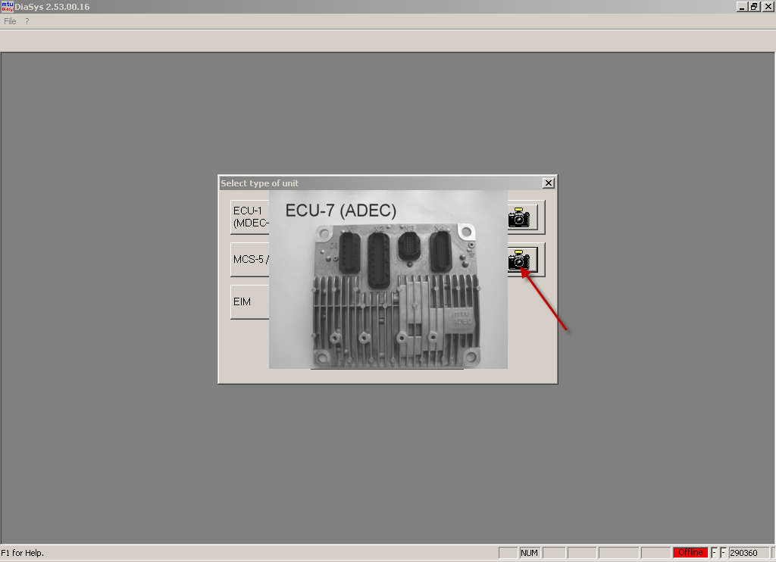
If you are not sure what controller you are working with, select a picture to view.

Slide 22
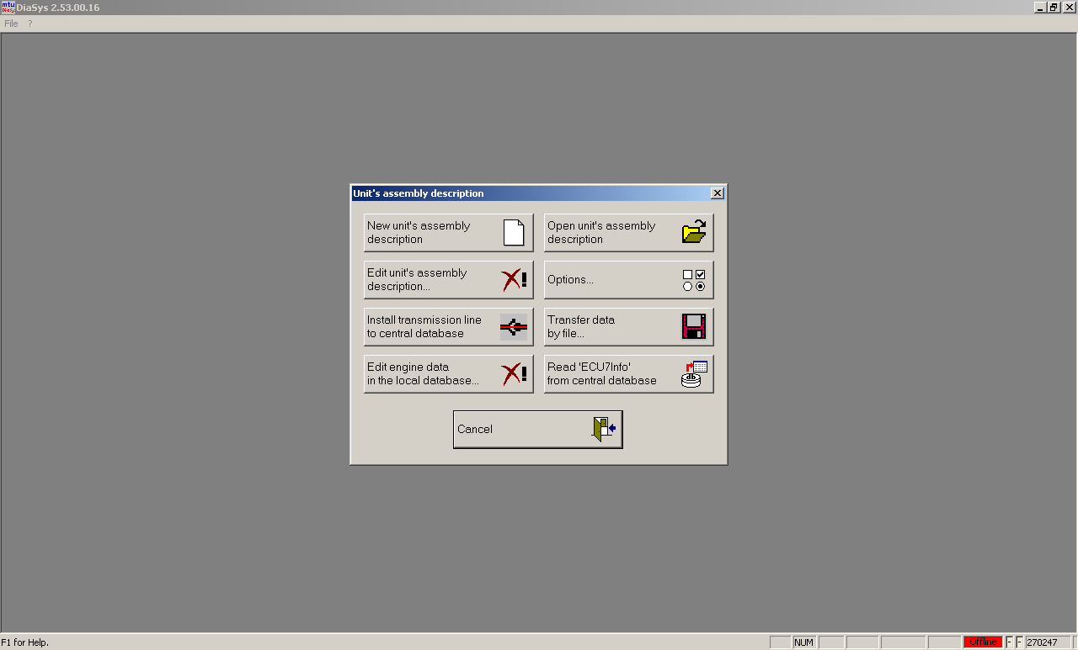
Three Options Used Most in the Field
Entering a new engine on YOUR computer
Open an engine description previously connected to
Transferring engine data (calibrations) to-and-from the ‘Mainframe’

Slide 23
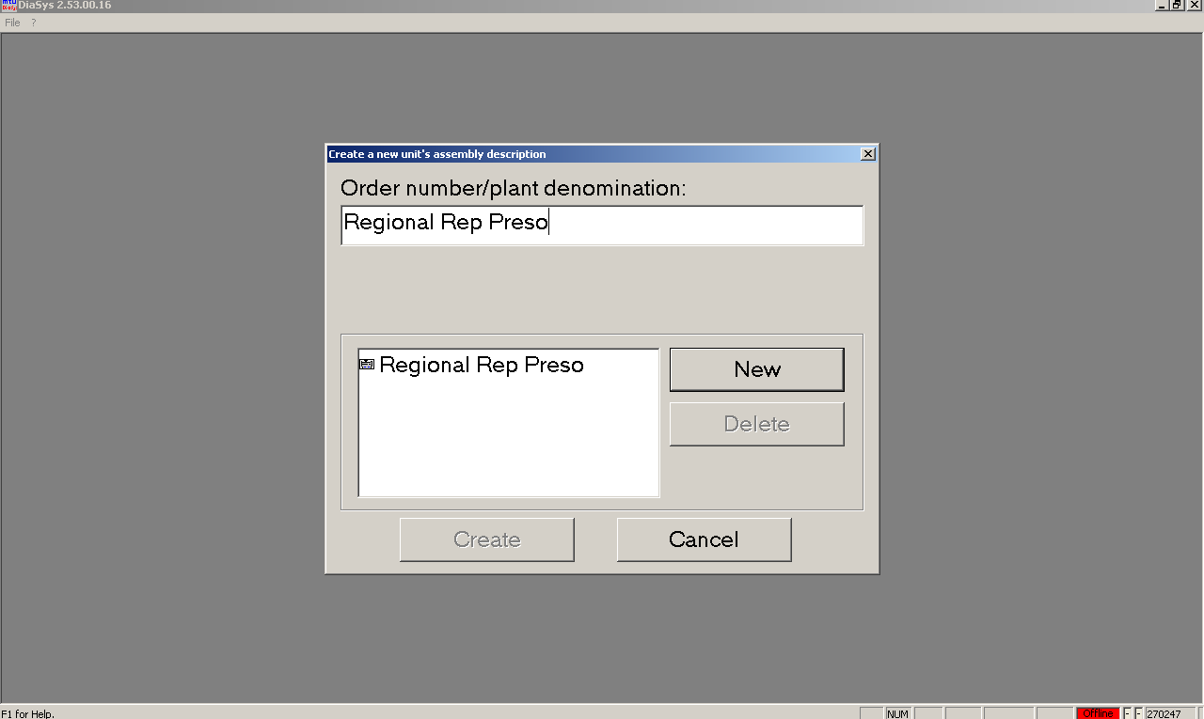
Preparing to connect to the ECU
Name of Project or Unit which you working on
Name can be anything to help you remember the project
Click on “New” to enter engine number

Slide 24
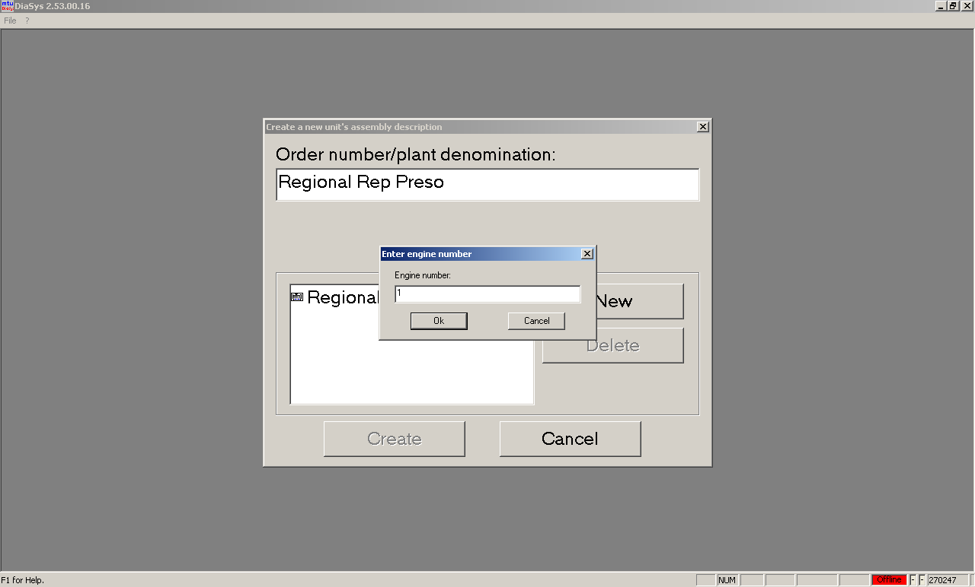
Preparing to connect to the ECU
Engine Number can be entered OR a simple digit. DiaSys will automatically correct when connecting to the governor.
More than one engine can be entered by clicking ‘New’ again.
Click ‘OK’ when engine(s) is entered
Click ‘Create’ when all engines are entered

Slide 25
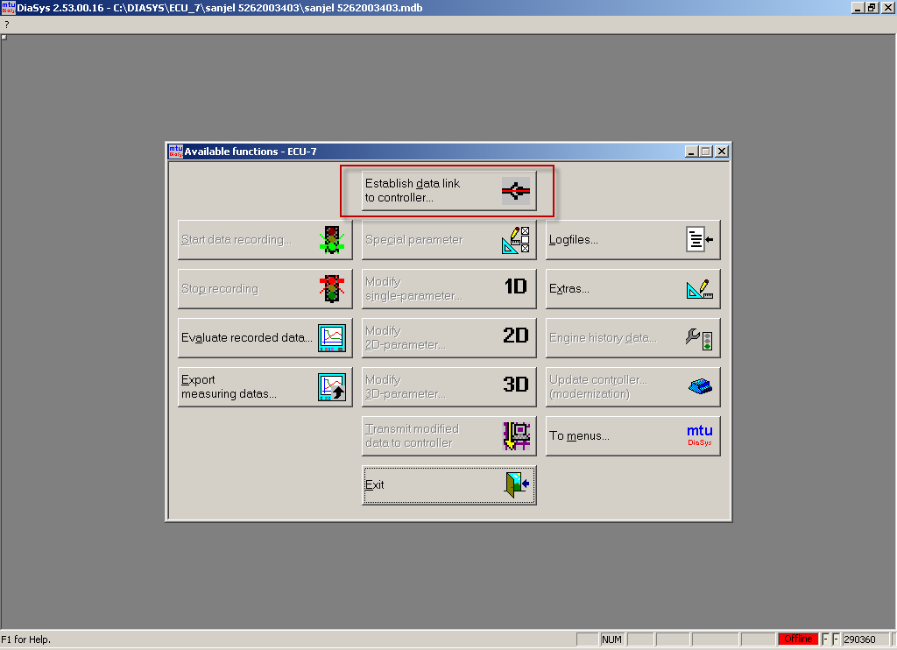
Connect to the ECU
Few options are available until a connection to the governor has been made.

Slide 26
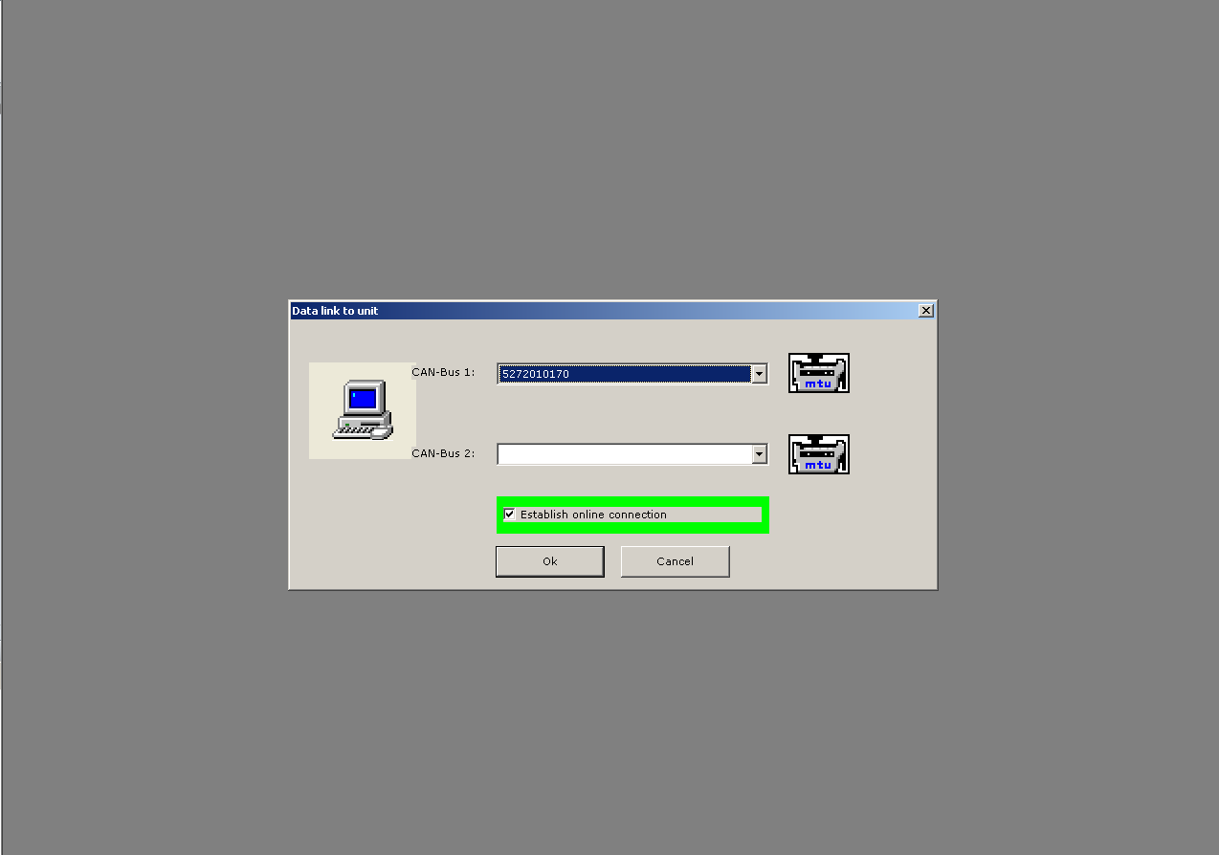
Connect to the ECU
Drop-down menu will show the units you specified in the folder.
Select unit number which you wish to connect to
As mentioned earlier, DiaSys will automatically correct any errors in your number selection
Clicking ‘OK’ will begin the connection process.
This process will take several minutes (less if connected to this engine previously)
Warnings and information pop-ups will appear during connection process
Click OK/Yes for all
The Green box ‘Establish Online Connection” is critical as follows:
Box checked for connection / update of controller.
Box UNchecked for controller delete and reflash.

Slide 27
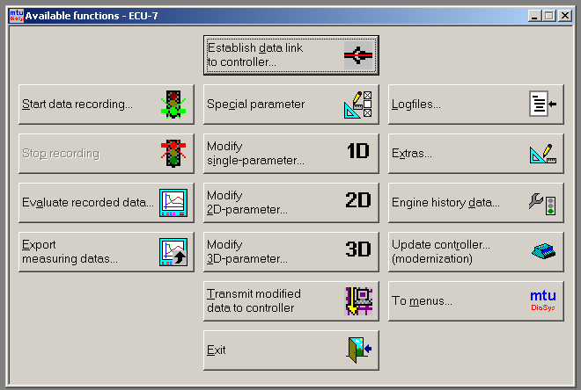
Diasys Error Log

Slide 28
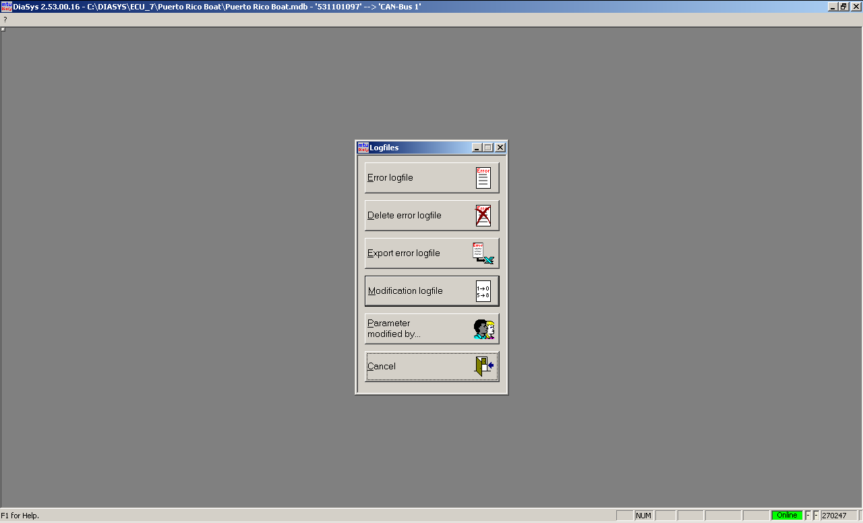
Diasys Error Log
Download the current error log file
Delete the log file after a repair
List of all ECU activity
Export the log to an Excel spreadsheet to save/e-mail
List of ‘WHO’ changed ‘WHAT’, and ‘WHEN’

Slide 29
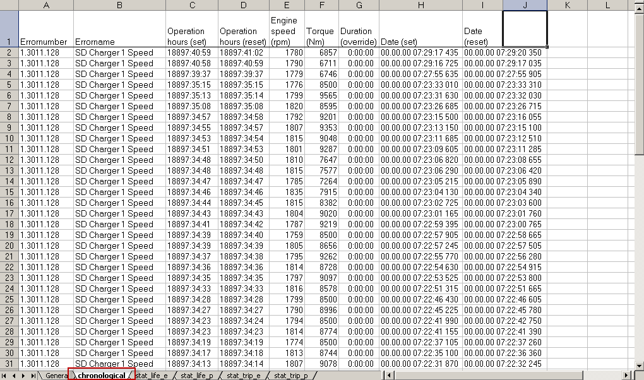
Diasys Error Log

Slide 30
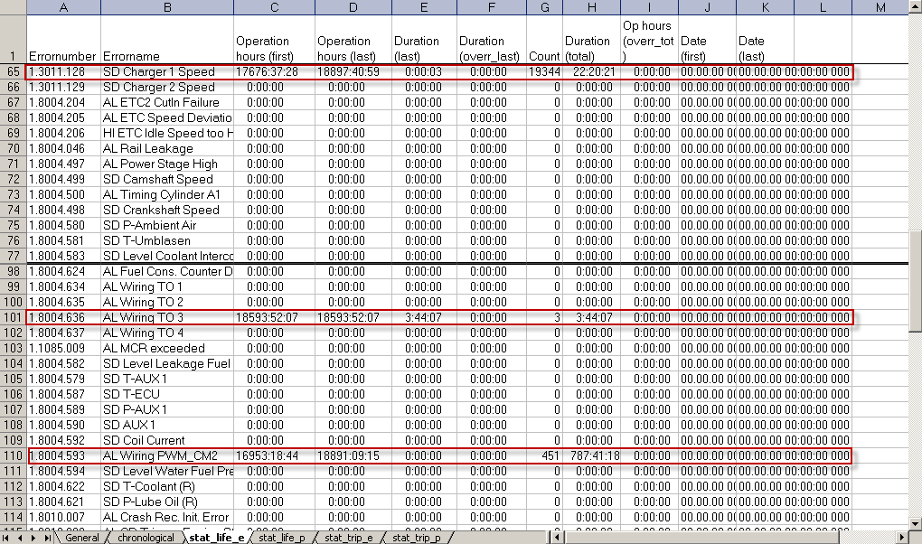
Open the statistical error log.

Slide 31
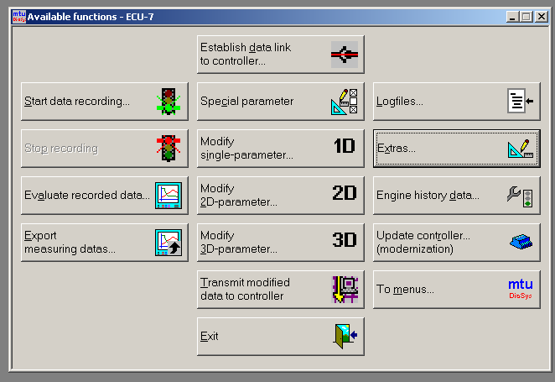
DiaSys Injector Test

Slide 32
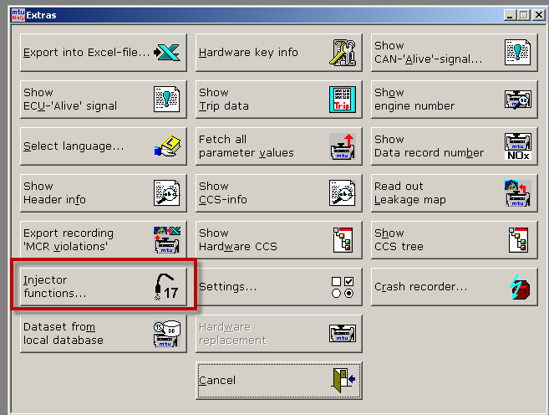
DiaSys Injector Test

Slide 33
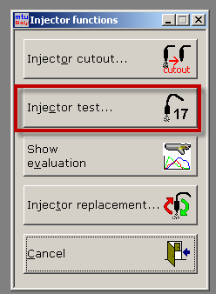
DiaSys Injector Test
Injector Test
This is used to test the fuel injectors while the engine is running.
Its best performed under load
Should be repeated at least twice

Slide 34
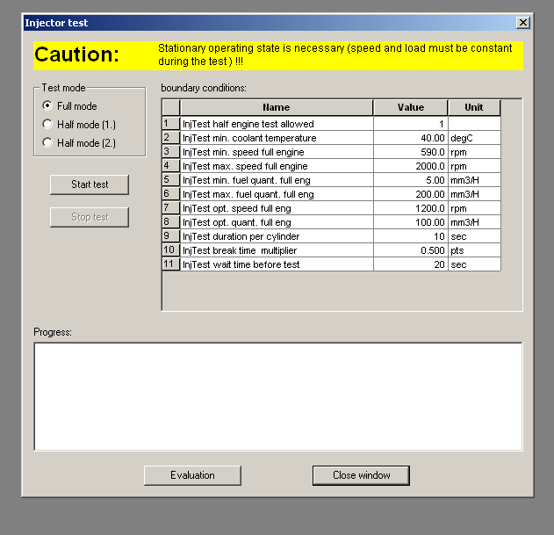
DiaSys Injector Test
Injector Test
The test screen will tell you the limits in which the test can be performed.
Push Start Test and wait a few minutes.
It will display the contribution of each cylinder and if it is considered a problem or not.

Slide 35
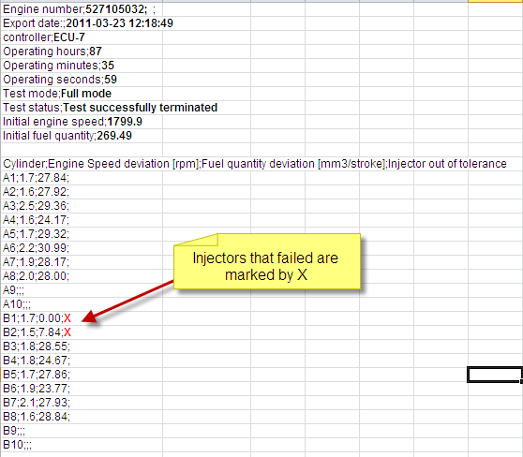
DiaSys Injector Test
Injector Test
If the Injector Test Evaluation cal is turned on, this data will be displayed in the results.

Slide 36
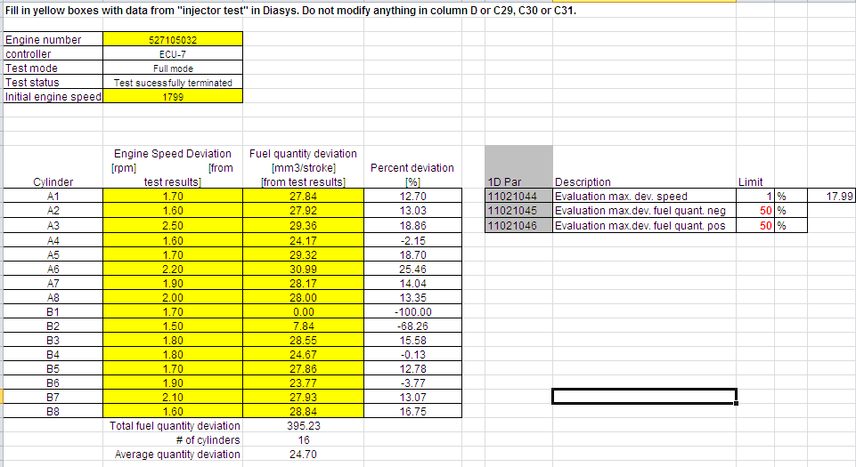
DiaSys Injector Test
This is a manual evaluation sheet for an injector test.
It will show how the data is used to determine injector contribution.

Slide 37
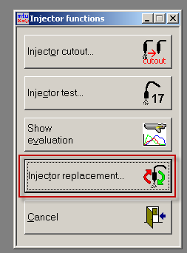
DiaSys Injector Test
Injector Replacement
(ADEC 7 ONLY)
This is used to reset the operating hours of the fuel injectors.
Injector function receives compensation based on hours to maintain emissions levels.
Must change data when injector is installed.

Slide 38
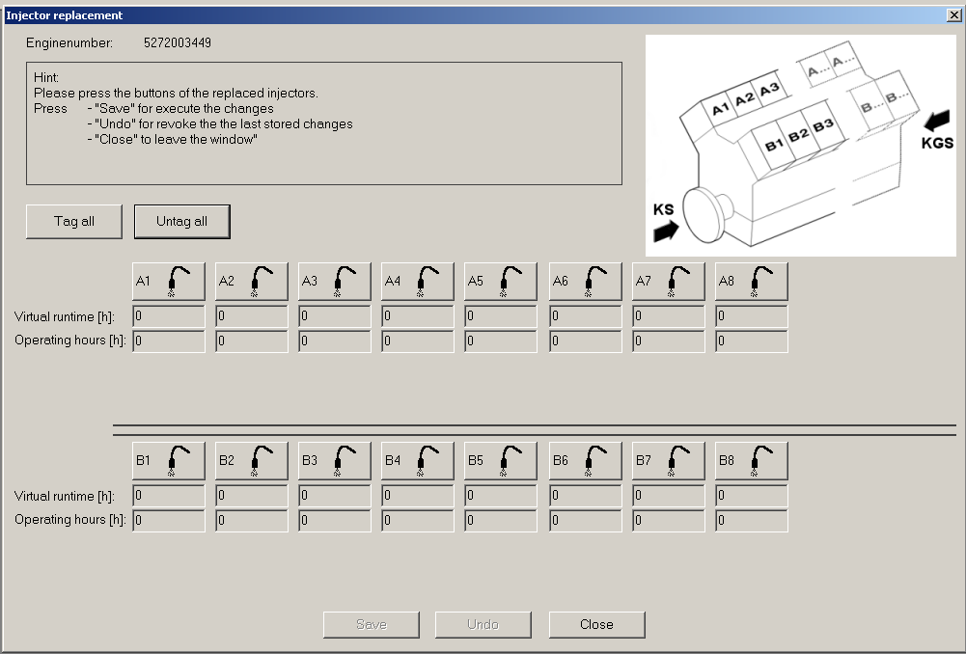
DiaSys Injector Test

Slide 39
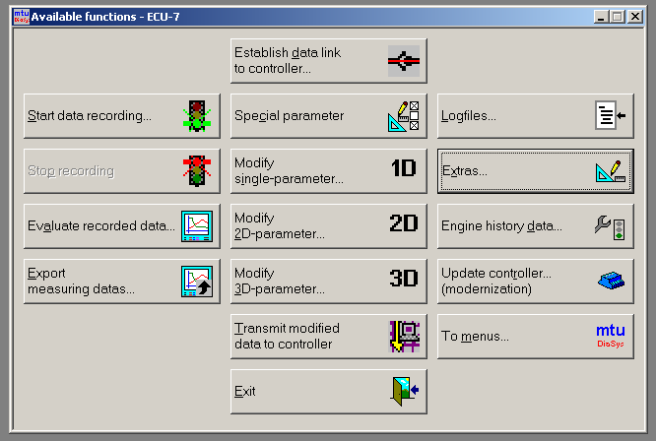
DiaSys Recordings

Slide 40
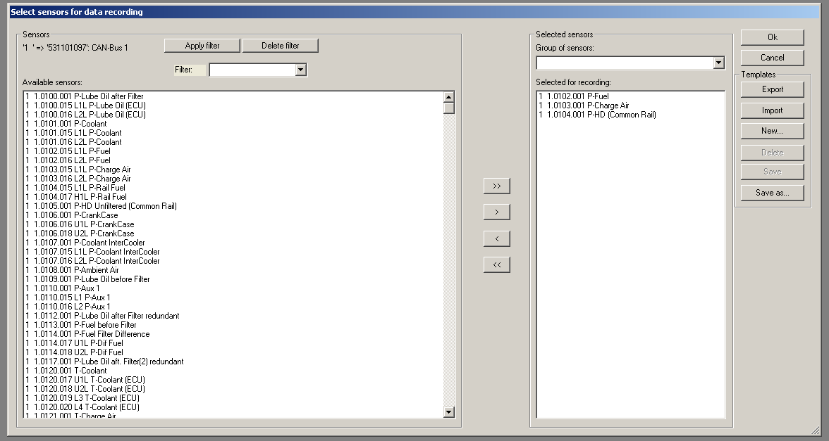
DiaSys Recordings
List of ALL recordable parameters available
Parameters selected by the user which will be recorded

Slide 41
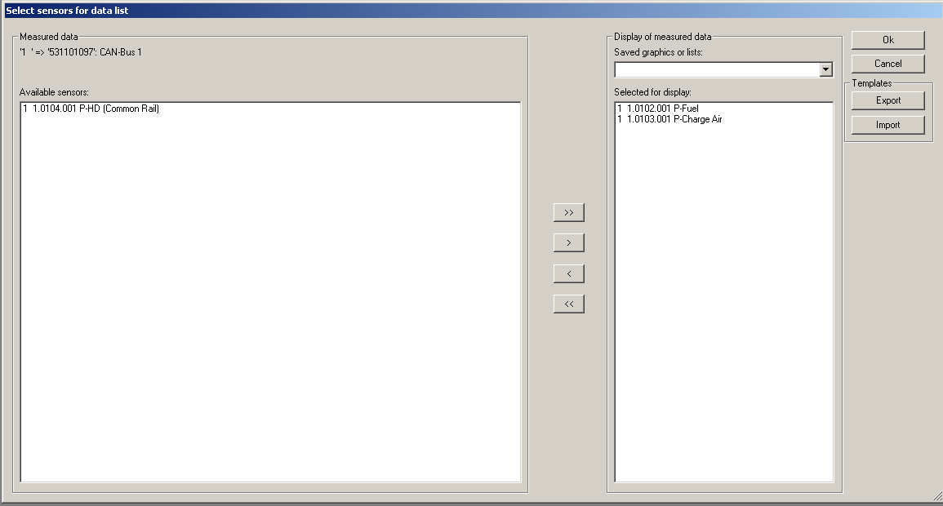
DiaSys Recordings
Two similar screens will appear
The first will show the selected recorded data ‘Live’ in a list
The second will show the selected recorded data ‘Live’ on a graph
The parameters on the left are ALL parameters which are being recorded
The parameters which the user wants to view are moved to the right by the user
The parameters on the right are shown on the screen after clicking ‘Ok’

Slide 42
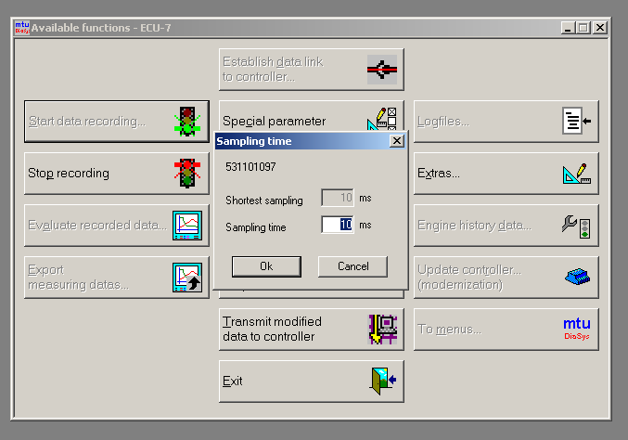
DiaSys Recordings
Sampling time is the rate at which DiaSys will record the data to your computer.
The ‘Shortest sampling’ and ‘Sampling time’ should match
Shorter sampling times are preferred.
Long sampling times can result in ‘altered’ data
After clicking ‘Ok’ the recording has started

Slide 43

DiaSys Recordings
After clicking ‘Stop recording’ the following screen appears
To save the data click on ‘Yes’
Choose your location to save it, name it and click Save

Slide 44
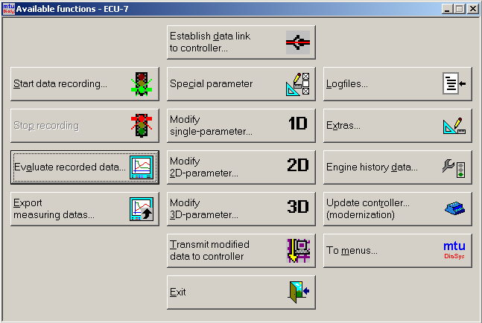
DiaSys / Upload or Download files

Slide 45
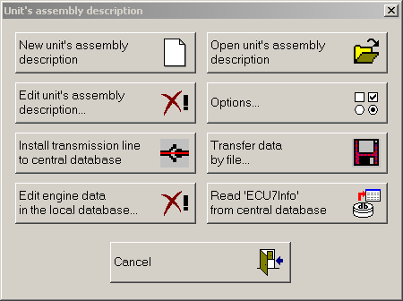
DiaSys / Upload or Download files

Slide 46
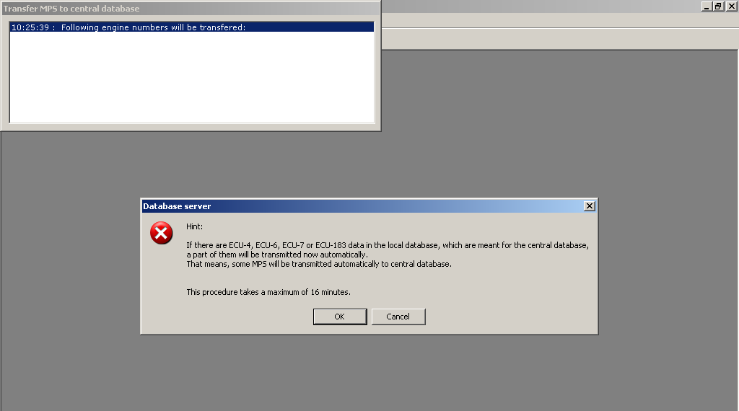
DiaSys / Upload or Download files
Before downloading cals, Diasys will send any calibration data from your PC back to the server.

Slide 47
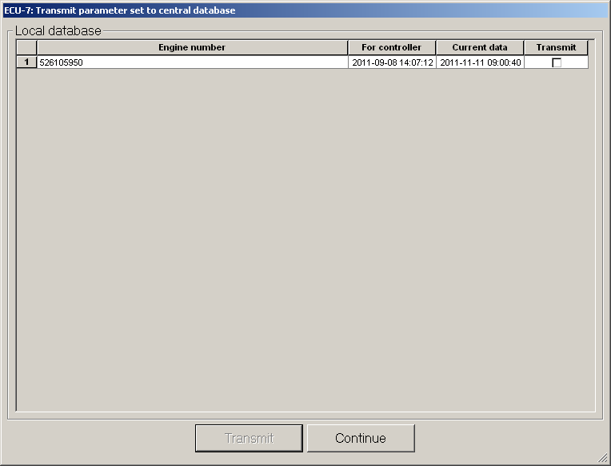
DiaSys / Upload or Download files
This screen shows which engine serial numbers will be sent back.

Slide 48
DiaSys / Upload or Download files How to control files that upload.

Slide 49
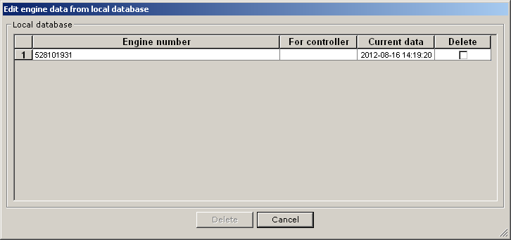
DiaSys / Upload or Download files How to control files that upload.
If you delete the engines from this database, the cal will not be sent back to the mainframe.
This should only be done if you made temporary changes for test purposes.

Slide 50
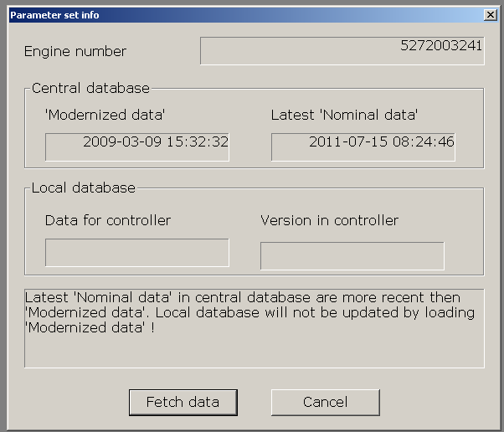
DiaSys / Upload or Download files
Enter engine #
Select Modernized or Nominal Data
Modernized data means the calibration has been updated on the server.
Nominal means the cal has been loaded into a ECU and reported back to the server.

Slide 51
DiaSys Basics Recordings
DiaSys / Upload or Download files
Diasys will tell you if there is newer data available.
After selecting the cal you want, it will automatically be placed in the folder with this serial number.

Slide 52
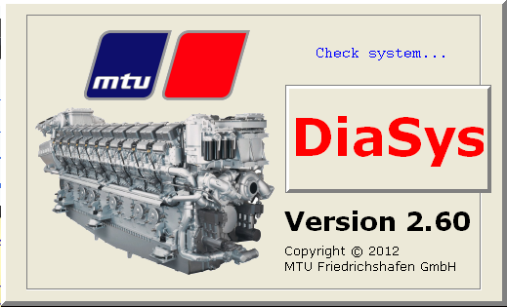
Diasys Advanced Information

Slide 53
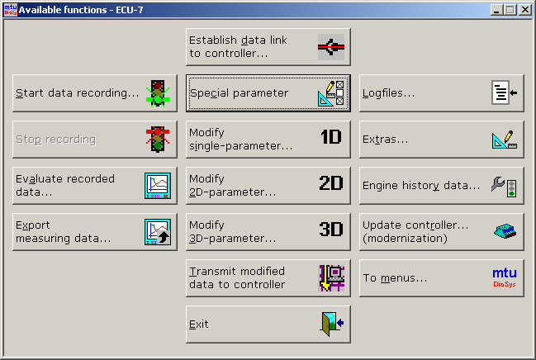
Diasys Functions
Special Parameters
This is used to:
Configure inputs
Configure outputs
Diagnostic trouble code response.

Slide 54
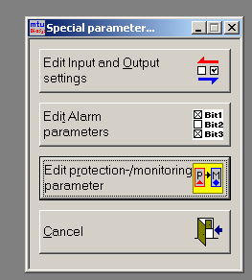
Diasys Functions
Special Parameters
This is used to:
Configure inputs & Outputs
Diagnostic trouble code response.

Slide 55
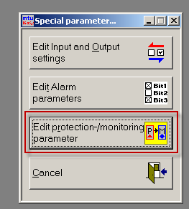
Diasys Functions
Diagnostic trouble code response.

Slide 56
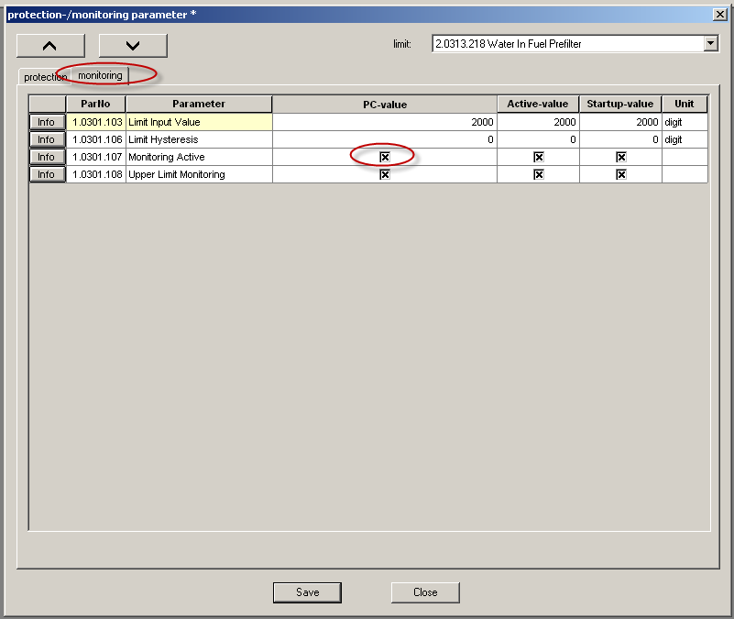
Diasys Functions
Select DTC
If Monitoring is turned off, this code will not set.

Slide 57
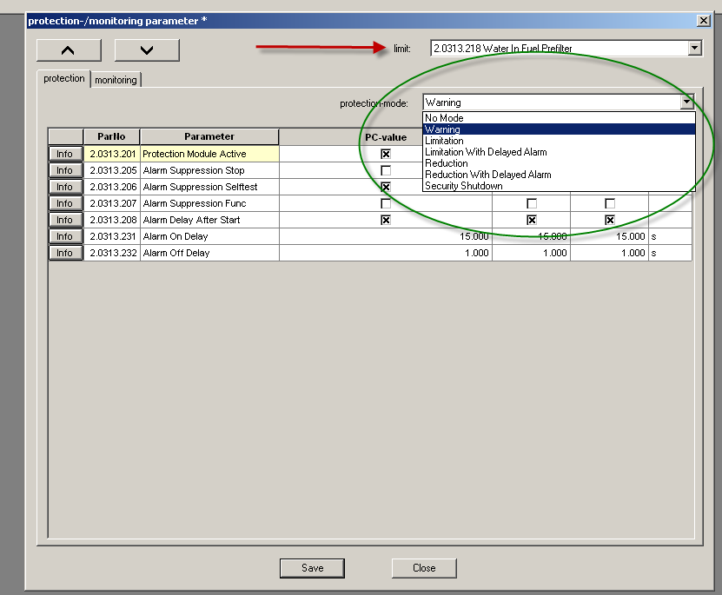
Diasys Functions
Select DTC
If monitoring is on,
This will set the response to the code.
Choices:
No response
Warning only
Speed Limitation
Torque Limitation
Engine Shutdown

Slide 58
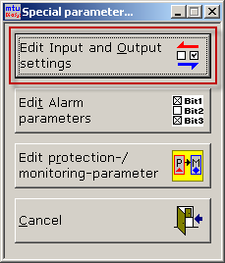
Diasys Functions
Edit Input and Output settings
Configure Red and Yellow lights
Set up feedback circuits from ECM
Set up Binary inputs (Start/Stop, override, etc.)

Slide 59

Diasys Functions
Edit Input and Output settings
Assign each output channel from ECM.
Active High or Low means circuit requires +24V to activate.

Slide 60

Diasys Functions
Crash Recorder
The ADEC crash recorder is a circular memory system that monitors key parameters.
In the event of certain serious trouble codes, the data in memory is stored from before during and after the event for future use.
The file can be downloaded and sent to MTU.

Slide 61

Diasys Functions

Slide 62
Diasys Functions
MDEC or ADEC Load Profile Table
What is the load profile data?
How do I find it?
What can I do with it?

Slide 63

Diasys Functions
MDEC Load Profile Table Download

Slide 64

Diasys Functions
MDEC Load Profile Table Converted to Load Factor

Slide 65

Diasys Functions
MDEC Load Profile Table Converted to a Chart
What can this be used for?
Some customers want to understand the operating conditions of their engine.
It can tell you if the engine may be over or under powered for its intended use.
Many maintenance contracts are tied to load factor. Most customers guess at this number.
It may reveal opportunities for cost savings. This engine has over 5000 hours of idle time. A 20V4000C22 uses about 4.2 Gal/Hr idling.
@ 4/Gal = Aprox $89,000 in fuel.

Slide 66
Diasys Functions
How to record and analyze data with Diasys

Slide 67

Diasys Functions

Slide 68

Diasys Functions

Slide 69

Diasys Functions

Slide 70

Diasys Functions
Familiar screen
All parameters which were recorded are on the left
User chooses which parameters to view and moves them to the right

Slide 71


Diasys Functions
Parameter Information
P- Is a Pressure Parameter
L1L-P Coolant = Alarm Limit 1 (Yellow alarm)
L2L-P Coolant = Alarm Limit 2 (Red Alarm)
AL – Alarm Parameter
Fail code – Current DTC’s
AI1 Rohwerte- Analog Input 1 Raw data
FIP Rohwerte – Frequency Input Raw Data

Slide 72


Diasys Functions
Parameter Information
T- Is a Temperature Parameter
U1L-T Fuel = Alarm Limit 1
(Yellow alarm)
U2L-T Fuel = Alarm Limit 2
(Red Alarm)
It is critical to check all STOP inputs when investigating a NO Start.
The engine may crank but will not start with the Stop activated

Slide 73

Diasys Functions
Torque limitation code.
This will show the full load capability of the engine.
If the engine cannot make full power due to smoke control or DTC issue, this will inform you.
NOTE: Code 1 = Normal operation.

Slide 74

Diasys Functions
Choose your recording
They will have a .rms extension
Click ‘Open’

Slide 75

Diasys Functions
Generator with long crank time.
Review of Diasys recording shows the high pressure pump is slow to build pressure.

Slide 76

Diasys Functions
Same type Generator with short crank time.
Diasys recording shows that this engine is functioning correctly.

Slide 77

Diasys Functions
2 Generators sharing the load.
Complaint:
1 engine cycles in and out of ½ engine.
Other 2 do not.
Diasys recording shows that these 2 engines are carrying different loads.
One is near threshold for ½ engine. Other is not.

Slide 78

Diasys Functions
This engine had an issue with uncontrollable rail pressure.
It would set codes for high and low pressure conditions.
The parameter for coil resistance is for the pump control coil.
Approx. 2 Ohms are normal. This engine had 440 Ohms.
Loose connector.

Slide 79

Diasys Functions
Example of normal resistance.

Slide 80

Diasys Functions
Another Rail Pressure problem example.
Rail Pressure command is steady, actual pressure is uncontrollable.

Slide 81

Diasys Functions
Complaint:
Generator has slow response to load.
NOTE: This is not full load condition.
See torque limitation code.
8 = Smoke control.
This is limiting fuel and slowing engine response.

Slide 82

Diasys Functions
Complaint:
Low power on Generator
Full Load
RPM is low
Torque limitation code = 1 (good)
If all environmental conditions are OK, this engine may be low on power.
Injector, Airflow or EOL trim

Slide 83





SAM Module Information
SAM Module
Compact Flash Card
CAN Resistors
SAM Connectors
CCB Card

Slide 84
SAM Module Information
Using Diasys with SAM
CF Card Programming.
Field Data Handling.
SAM software level

Slide 85
SAM Module Information
The first step in using Diasys to connect with a SAM unit is to locate the correct Diasys.dat file.
This file is unique to each SAM software release.
It tells Diasys what parameters are available to view and modify.
It will be located on the FTP server or each CF card.

Slide 86

Find the Diasys.dat file for this SW set

Slide 87

Select SAM

Slide 88

Create a new description for this SAM

Slide 89

Create a new description for this SAM

Slide 90

Open the description for this SAM

Slide 91

Read the assembly description for this SAM
This tells DiaSys what parameters are available to view and change

Slide 92

Establish link

Slide 93

Establish link

Slide 94

Select Module to log into.

Slide 95

Select Module to log into.

Slide 96

Now you are ready to change / take data.

Slide 97
Diasys Functions
SAM Module Information
Using Diasys with SAM
CF Card Programming.
Field Data Handling.
SAM software level

Slide 98
Diasys Functions
SAM Module Information
When a SAM file is sent via email, most likely the file structure will not work on a CF card.
Certain files must be available on the root directory.

Slide 99

The CF cards should be pre-formatted.
However if you have to format one, it must be formatted in FAT protocol.

Slide 100

Cards should be pre-formatted.
However if you have to format one, it must be formatted in FAT protocol.

Slide 101

FAT 32 formatting will not work.
Only FAT is OK.

Slide 102

Files as received from MTU
The SAM must be able to see the files inside this folder.
WRONG !!!

Slide 103

CORRECT EXAMPLE OF SAM CF CARD FILE STRUCTURE

Slide 104
Diasys Functions
SAM Module Information
Using Diasys with SAM
CF Card Programming.
Field Data Handling.
SAM software level

Slide 105
Diasys Functions
SAM Module Information
The SAM software has a new feature in most applications called “Field Data Handling”.
This SAM software will “read” the ADEC software, cals and engine hours upon first power-up and updates the information regularly.
This feature will allow the ADEC to be replaced with no MTU support.
If a new ADEC is installed, the SAM will program the software, cal and hour information.
However, if FDH is used, the ADEC will set a code 555 alarm and a Yellow light.

Slide 106

Diasys Functions
SAM Module Information

Slide 107
Diasys Functions
SAM Module Information
Due to this new feature, it is not longer possible to swap SAM modules between machines. The SAM will set a code for incorrect data between the SAM and ADEC.
The secondary issue with this feature is the SAM CF cards. The cards have not changed, but because they save specific information, are no longer easily interchangeable between machines.

Slide 108
When the Life Data function is turned on, the SAM will create many new files when it is used for the first time.
These files store the ADEC serial number, software, cal and run time.
BEFORE installing in SAM

Slide 109

When the Life Data function is turned on, the SAM will create many new files when it is used for the first time.
These files store the ADEC serial number, software, cal and run time.
AFTER installing in SAM

Slide 110
Diasys Functions
SAM Module Information
Using Diasys with SAM
CF Card Programming.
Field Data Handling.
SAM software level

Slide 111

To determine the SAM node number and software level, this can be found in the plant.txt file.
AFTER installing in SAM

Slide 112

This is the software level in the plant.txt file.
It is 40012 level 20
AFTER installing in SAM

Slide 113

Under the device heading, this will tell you the SAM device number.
AFTER installing in SAM

Slide 114

At the bottom of the page, the BUS device name list will indicate the node number for each module.
This may be different for each SAM software application. Ex. Generator, Frac, Marine may have different nodes assigned. If you install a used SAM, this needs to be verified.
AFTER installing in SAM

Slide 115
Thank You !

