Slide 1
Using Diasys to access the SAM module.
How to format the SAM CF card.
June 27, 2012
1

Slide 2
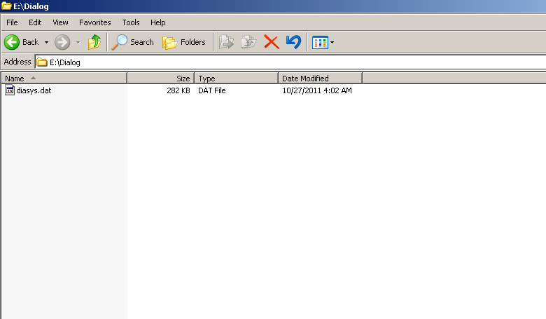
Before accessing the SAM, the Diasys.dat file is required.
The file is on the CF card.
NOTE: Each software version has a different Diasys.dat file.
June 27, 2012
2

Slide 3
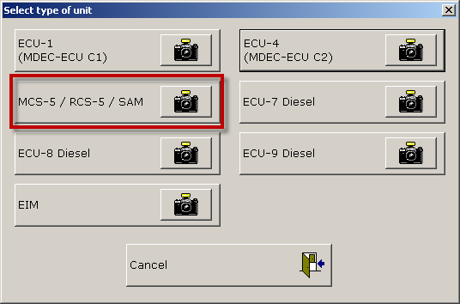
Select SAM
June 27, 2012
3

Slide 4
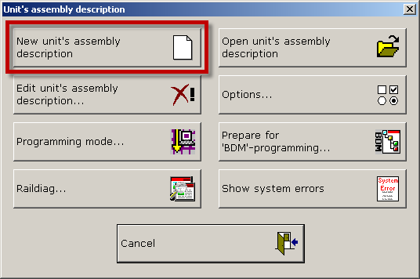
Create a new description for this SAM
June 27, 2012
4

Slide 5
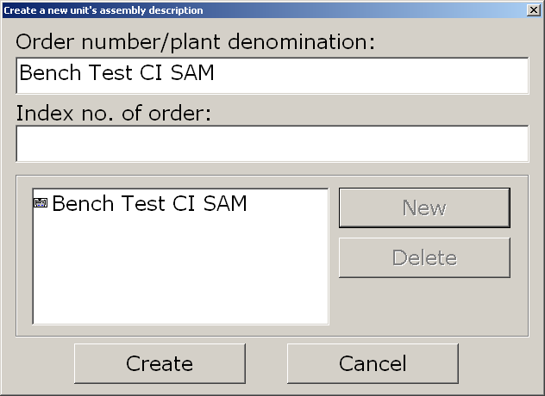
Create a new description for this SAM
June 27, 2012
5

Slide 6
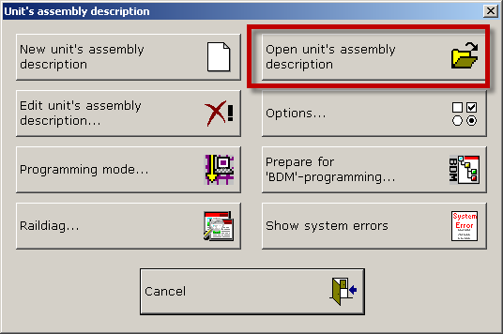
Open the description for this SAM
June 27, 2012
6

Slide 7
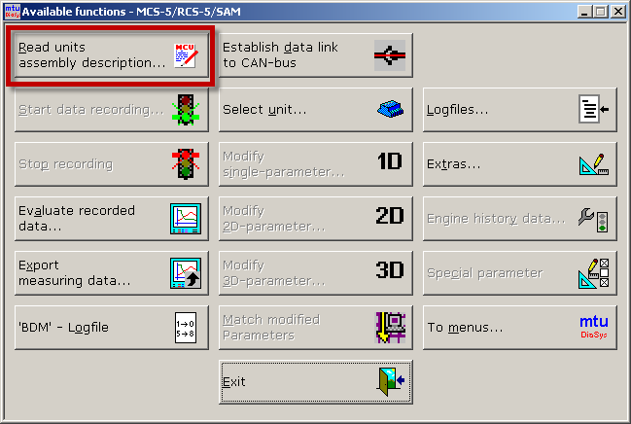
Read the assembly description for this SAM
This tells DiaSys what parameters are available to view and change
June 27, 2012
7

Slide 8
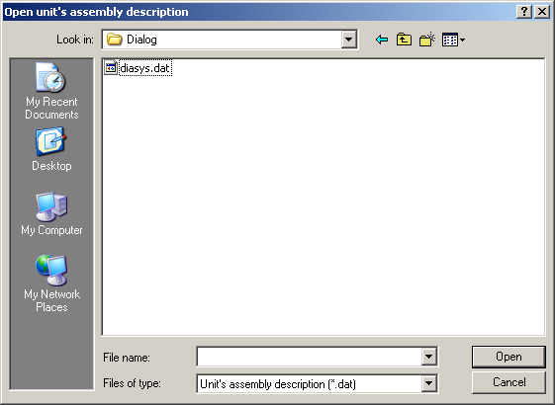
Find the Diasys.dat file for this SW set
June 27, 2012
8

Slide 9
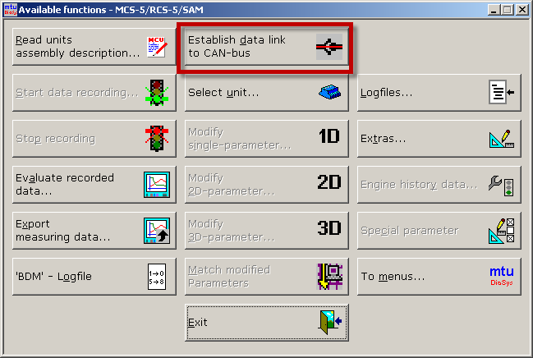
Establish link
June 27, 2012
9

Slide 10
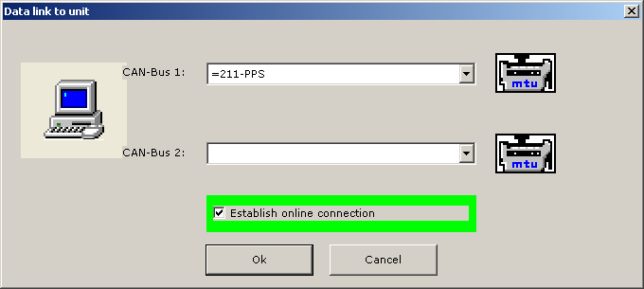
Establish link
June 27, 2012
10

Slide 11
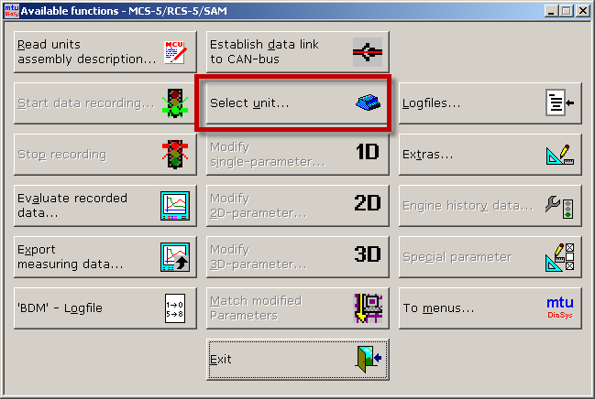
Select Module to log into.
June 27, 2012
11

Slide 12
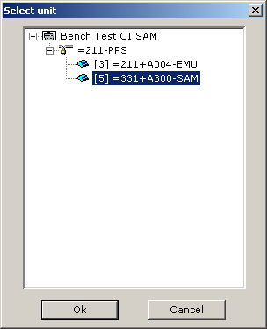
Select Module to log into.
June 27, 2012
12

Slide 13
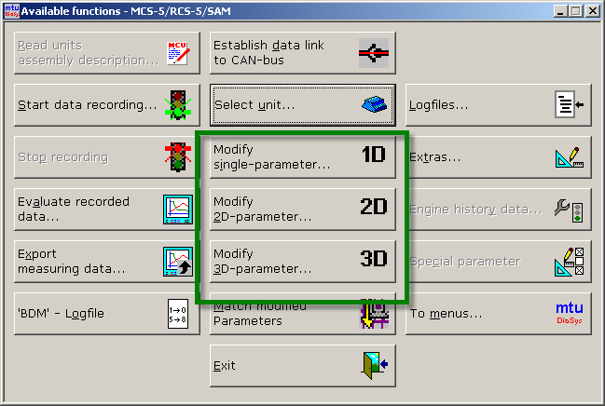
Now you are ready to change / take data.
June 27, 2012
13

Slide 14
SAM CF card information.
June 27, 2012
14

Slide 15
SAM CF cards must be formatted correctly or they will not function.
Both the file structure and card base formatting must be correct.
June 27, 2012
15

Slide 16
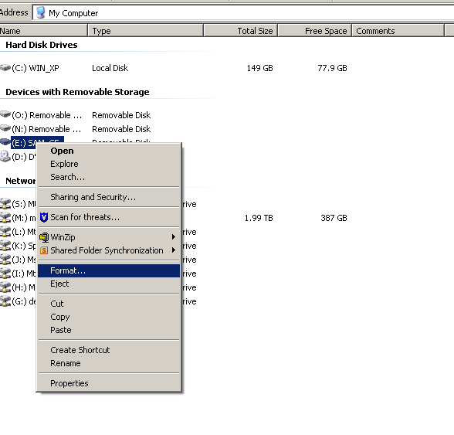
The CF cards should be pre-formatted.
However if you have to format one, it must be formatted in FAT protocol.
June 27, 2012
16

Slide 17
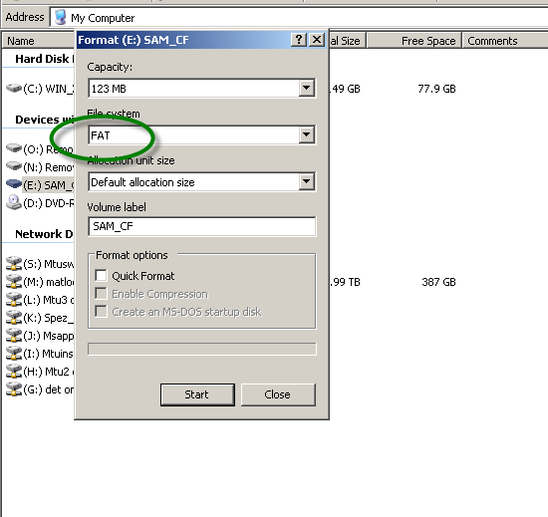
Cards should be pre-formatted.
However if you have to format one, it must be formatted in FAT protocol.
June 27, 2012
17

Slide 18
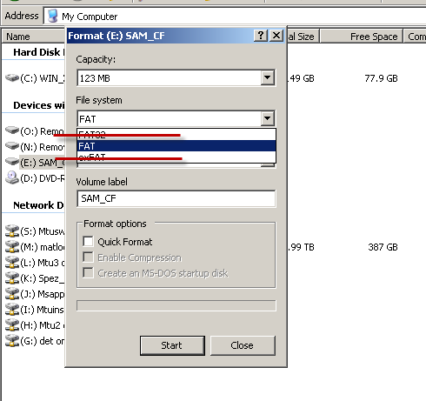
FAT 32 formatting will not work.
Only FAT is OK.
June 27, 2012
18

Slide 19
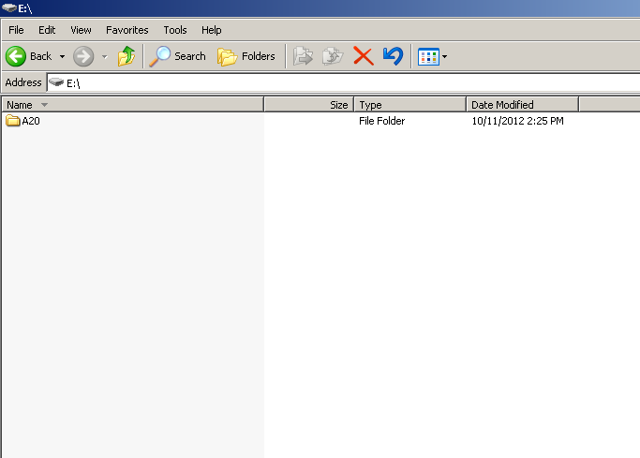
Files as received from MTU
The SAM must be able to see the files inside this folder.
WRONG !!!
June 27, 2012
19

Slide 20
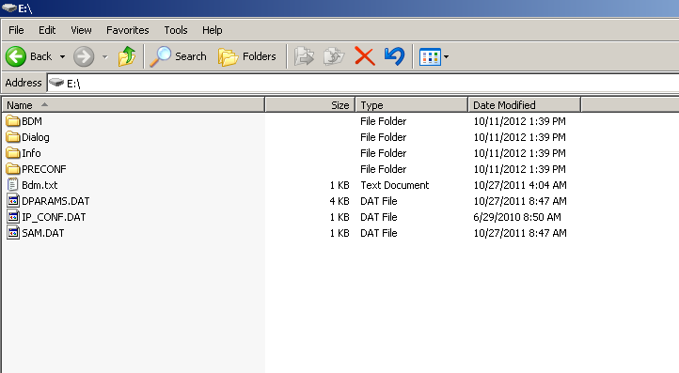
SAM BDM file must be in root (base) directory.
If not, you will get BDM error when installing CF card.
CORRECT EXAMPLE OF SAM CF CARD FILE STRUCTURE
June 27, 2012
20

Slide 21
When the Life Data function is turned on, the SAM will create many new files when it is used for the first time.
These files store the ADEC serial number, software, cal and run time.
BEFORE installing in SAM
June 27, 2012
21

Slide 22
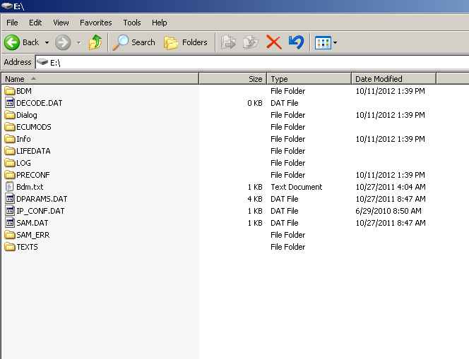
When the Life Data function is turned on, the SAM will create many new files when it is used for the first time.
These files store the ADEC serial number, software, cal and run time.
AFTER installing in SAM
June 27, 2012
22

Slide 23
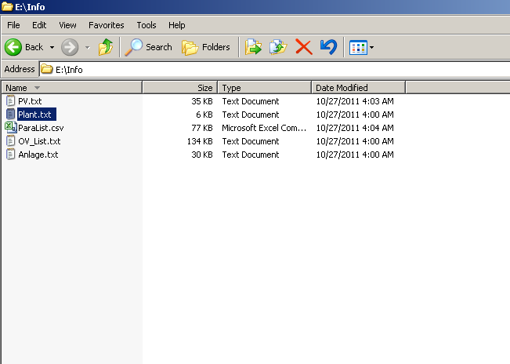
To determine the SAM node number and software level, this can be found in the plant.txt file.
AFTER installing in SAM
June 27, 2012
23

Slide 24
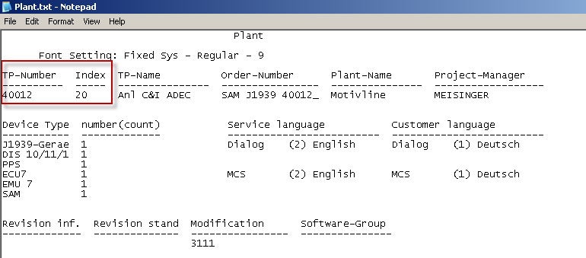
This is the software level in the plant.txt file.
It is 40012 level 20
AFTER installing in SAM
June 27, 2012
24

Slide 25
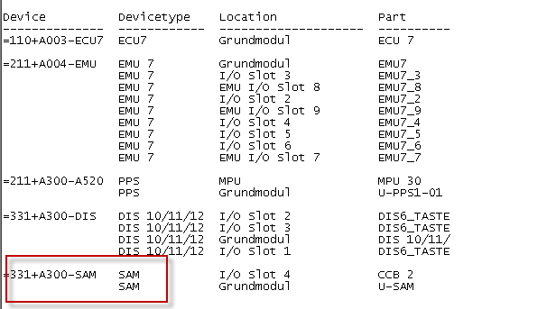
Under the device heading, this will tell you the SAM device number.
AFTER installing in SAM
June 27, 2012
25

Slide 26
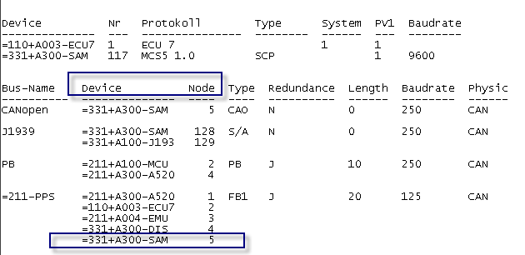
At the bottom of the page, the BUS device name list will indicate the node number for each module.
This may be different for each SAM software application. Ex. Generator, Frac, Marine may have different nodes assigned. If you install a used SAM, this needs to be verified.
AFTER installing in SAM
June 27, 2012
26

Slide 27
Installing a new CF card.
June 27, 2012
27

Slide 28
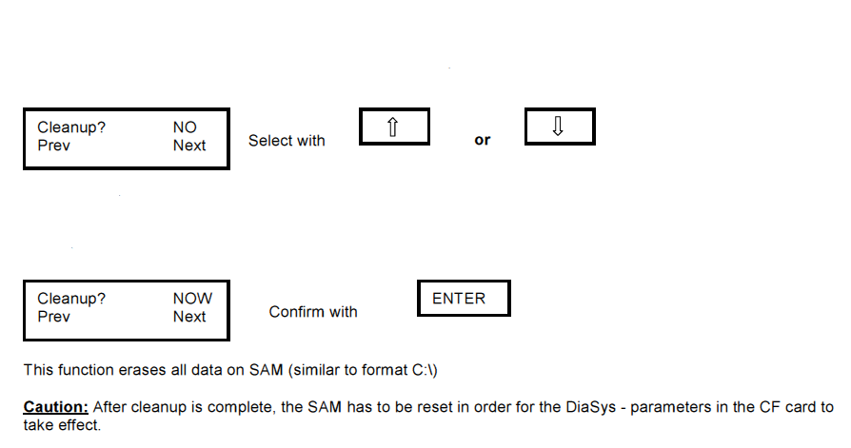
After installing new or reprogrammed SAM CF card, a "clean-up" must be performed.
Hold the ESC an ENTER keys on SAM during power-up.
The first menu item is Clean up

Slide 29
Thank you

